Slide 1
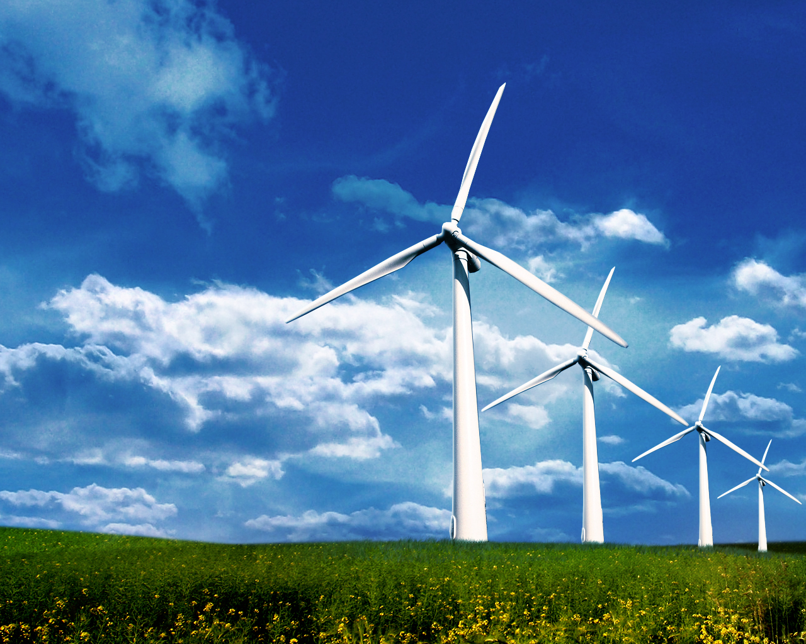
WIND FARMS!
By Georgia Casling

Slide 2
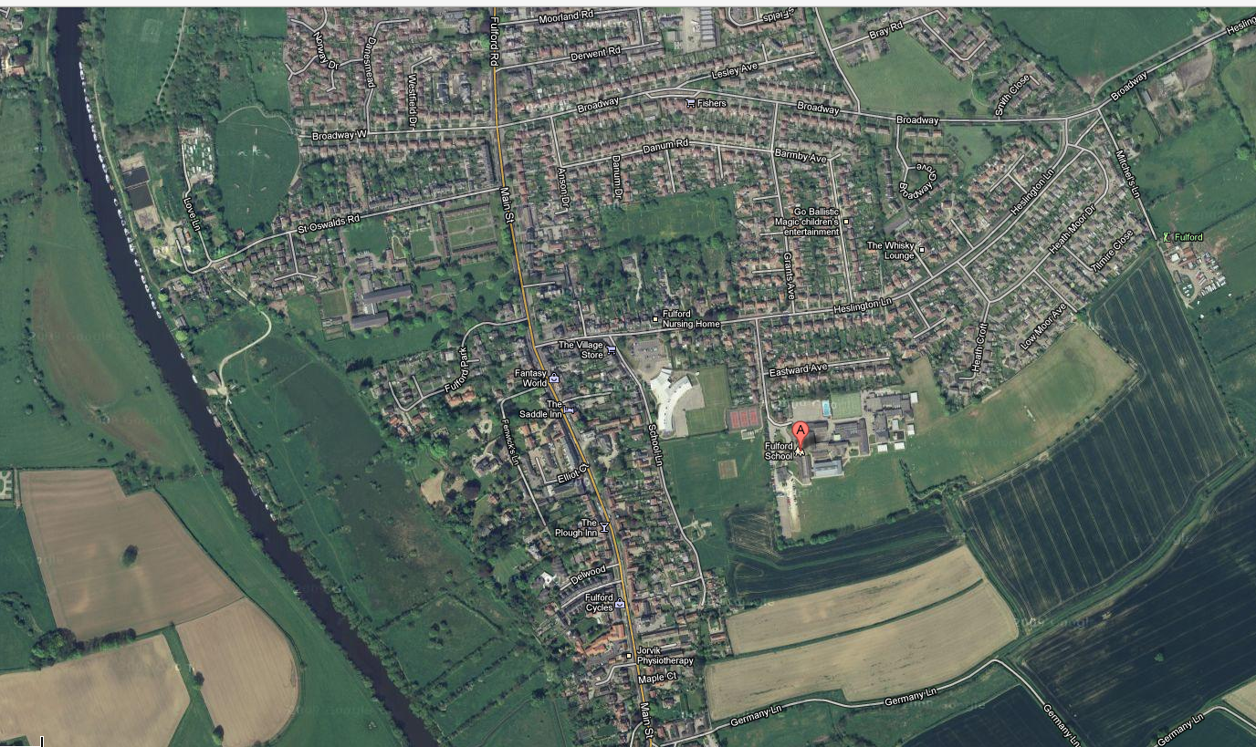
MY DESTINATION
My place for my wind farm is close to fulford school. It’s down Fulford park road and there are a row of houses at the end of the lane. So behind there is a big plot of land that I would like to use.

Slide 3
ADVANTAGES
Home wind Farms can be used to replace traditional energy sources with green, renewable energy.
Once up and running, wind turbines produce zero pollution; they are one of the most environmentally friendly sources of energy available at present time.

Slide 4
DISADVANTAGES
Wind power cannot be completely relied upon as wind can not be a constant source of power.
Wind turbines are often clustered together in ‘Wind farms’ which are often described as unattractive and spoiling of the countryside. Wind turbines are noisy, a problem particularly when installed close to homes and buildings and also matching the speed of that high speed of traffic

Slide 5
DIAGRAM
Just three steps to get a wind farm going
3) Rotor and blades spin the main shaft (c) and gearbox (d) which spins the generator (g), resulting in electric output
1) Inflow of wind goes through
2)Inflow of wind activates rotor (a) and blades (b)

Slide 6
WHY I CHOSE THIS LAND?
I chose this piece of land because it has a nice open field with no development on the site. It is near houses so that will give some of the houses electricity and their bills will be lower. It will also lower their carbon footprint.

Slide 7
BUT WHAT WOULD OTHER PEOPLE THINK?
Some other people will think that it will kill wildlife (like birds)
Some people may think it’s not nice to wake up the next morning instead of seeing the sunrise you see a wind farm blocking the view
But on the other hand some people will think it’s nice because it will save them energy
Wind turbines are available in a range of sizes which means a vast range of people and businesses can use them. Single households to small towns and villages can make good use of range of wind turbines available today

Slide 8
THANKS FOR WATCHING!

