Slide 1
Objectives
Describe the different body types
Explain the effect each can have on participation
Identify where different body types are an advantage

Slide 2
Learning Outcomes
Define somatotype and know the three types in an exam style question.
Know how difference in physique may effect performance and success in sport and answer a question related.

Slide 3
Starter
b) During the half-time break of a football match the players will drink lots of water. Explain why this is necessary.

Slide 4
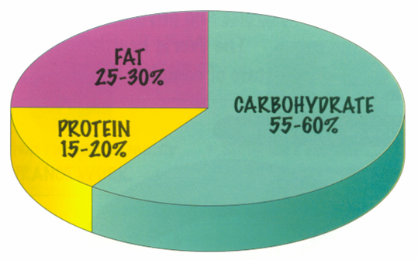
ANSWERS
a)
b)
When you exercise you lose water through sweat. This needs to be replaced in order to avoid dehydration and onset of fatigue.

Slide 5
Discuss with the person next to you-
What type of things do you think will effect a persons ability to perform and be successful in sporting activities?

Slide 6
PE and me
What type of body type do you think you are?
What sports do you think your body type is best suited to? Why?
Do you think its important to be a certain shape to succeed in a sport?

Slide 7
Somatotyping
Somatotyping describes the type of body build of a person.
Size , weight and shape may dictate the type of sport a person can participate with reasonable success (i.e. a tall person may be well suited to high jump or basketball).
These body types are classified into three groups:
Endomorph.
Mesomorph.
Ectomorph.

Slide 8
Extreme enDomorph – think D for dumpy
Generally referred to as round or pear shaped.
Fatty upper arms.
Thin wrists.
Wide hips.
Narrow shoulders.
Fatty thighs.

Slide 9
Extreme mesoMorph – think M for muscles
Muscular.
Broad shoulders.
Strong forearms and thighs.
Narrow hips.
Often referred to as an inverted triangle shape.

Slide 10
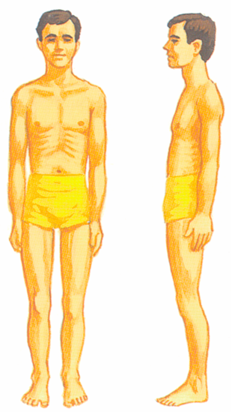
Extreme ecTomorph – think T for thin.
Often referred to as skinny.
Narrow face and high forehead.
Narrow shoulders.
Thin, narrow chest and abdomen.
Slim hips.
Long limbs, quite tall.

Slide 11
Vocabulary
Somatotype- classification of body type
Endomorph- an individual with wide hips and narrow shoulders, characterised by fatness
Mesomorph- an individual with wide shoulders and narrow hips, characterised by muscularity
Ectomorph – individual with narrow shoulders and narrow hips, characterised by thinness

Slide 12
Qs. What type of activities are Endomorphs best suited to?

Slide 13
What type of activities are Mesomorphs best suited to?

Slide 14
Qs. What type of activities are Ectomorphs best suited to?

Slide 15
Questions
1 — Study the list of sportspeople below. • Footballer • Jockey • Badminton player • Basketball player • Hockey player • Gymnast • Long-distance runner • Sumo wrestler • Sprinter
2 — Place each of them in a table which lists the somatotypes- ectomorph, endomorph and mesomorph.
3 — Choose one example from each somatotype and say why their physical characteristics suit that sport.

