Slide 1
Why should I take GCSE art?

Slide 2
It teaches you life skills - undertake research and investigation, problem solving, confidence building, visual awareness, ability to develop ideas, initiative and cultural and racial understanding.

Slide 3
Things you need to know about the course.

Slide 4
How does it follow on from what I have learned before?
The GCSE in Art & Design follows on from what you have been doing at Key Stage 3 (Years7-9).
The emphasis in GCSE Art & Design is on the process of developing both ideas and work. Central to this is your sketchbook in which you will complete and store your GCSE art work.

Slide 5
How is the course structured?
The GCSE in Art & Design consists of three parts. Two units of coursework and one externally set assignment – the timed examination.
Component | Completion | % of final GCSE grade | Method of Assessment | Requirements
Coursework 1 Natural Forms Coursework 2 Identity | To be completed during lesson time and for homework | 60% | Internally set Internally marked Externally moderated | Must include sketchbook and must show evidence of all assessment objectives
Externally set assignment | Eight weeks preparation time Ten hours timed examination | 40% | Externally set Internally marked Externally moderated | Must include sketchbook and must show evidence of all assessment objectives

Slide 6
What about coursework?
Your coursework should include research, supporting studies and work showing the development of your ideas, leading to one or more outcomes – (finished pieces of work). Your teacher will set you assignments and tasks.
You will be working in a variety of different media i.e. pencil, pastels, watercolour, mixed media and acrylic paint, as well as using different techniques such as printing (mono and lino), drawing, painting, frottage, collage.

Slide 7
How will my work be marked?
Your teacher will follow these assessment objectives when marking your work. Each objective will be considered equally and marks rewarded according.
Assessment objectives | % of total mark awarded
Develop and explore ideas using media, processes and resources, reviewing, modifying and refining work as it progresses | 25%
Analyse and evaluate images, objects and artefacts showing understanding of context | 25%
Record observations, experiences and ideas in forms that are appropriate to intentions | 25%
Present a personal response, realising intentions and making informed connections with the work of others | 25%

Slide 8
What about the exam? To complete your GCSE, you will have to take an externally set examination (ESA). This will take the form of a broad theme – for example, it could be something like ‘Change’ or ‘Time’. The exam paper will also contain some suggestions for possible starting points, areas of study and ideas regarding your research. You will be given the exam paper approximately five weeks before the date of the actual timed exam. You will then have the five weeks in which to prepare for the exam. During this time you must research and develop ideas and prepare for your final exam in your sketchbook, your teacher will be available to guide and advise you with this exam preparation. You may find it useful to brainstorm ideas by writing down everything that comes into your head, and then choosing one idea you can develop further. This work will be assessed according to your investigation, experimentation, documentation and presentation. At the end of the five weeks, you will sit a 10 hour timed examination (broken up into 2 days plus any extra sessions needed), during which you will produce your final piece(s) of work based on your research and preparation. Your exam preparation and developmental work, along with your final piece, will then be submitted for assessment. It is vital that your exam preparation is completed and handed in to your teacher by the deadline.

Slide 9
Will my work be displayed?
At the end of your course you are required to put up a display of your final pieces, including your exam piece and sketchbooks. This display will remain in place for the yearly art exhibition where your family and friends will be invited to view it. Your work will be assessed at this time by the art teachers. The work will then be brought down and put in your folders ready for it to be moderated.

Slide 10
What about homework?
You will be required to complete at least one hour of art and design home work every week. Home work contributes a very important part of the coursework and exam preparation. The home work could take the form of research i.e. taking photographs, collecting examples of art work from the internet, library or magazines etc., completing your own art work or writing up evaluations etc…

Slide 11
Will I take part in any visits?
You will go on visits to art galleries during your course where you will be expected to collect research material and/or complete your own pieces of art work.
Your teacher may suggest that you organise your own visits to relevant places to collect research material for your projects.

Slide 12
The following slides take you through a sketchbook, showing all the four areas which will be assessed.

Slide 13
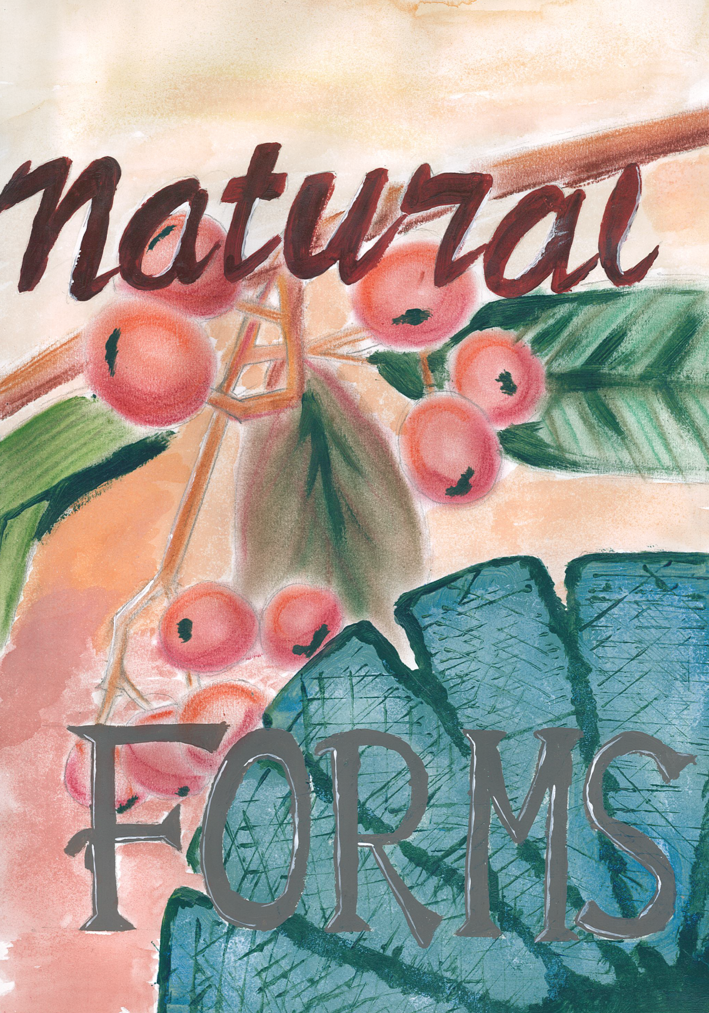
Natural Forms sketchbook, title page.

Slide 14
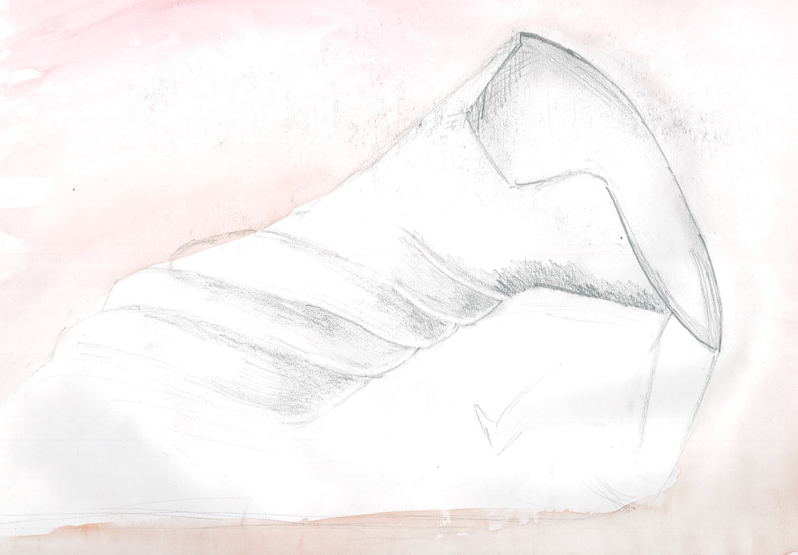
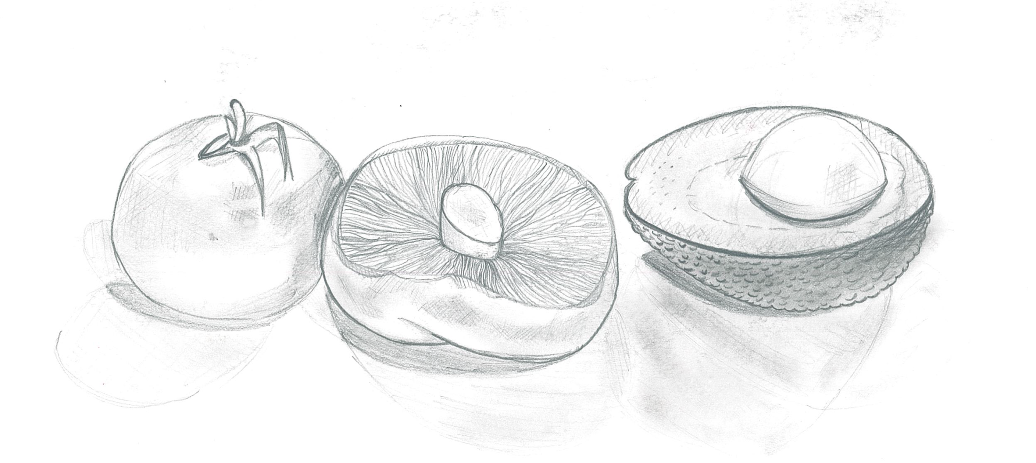
Observational drawings.

Slide 15
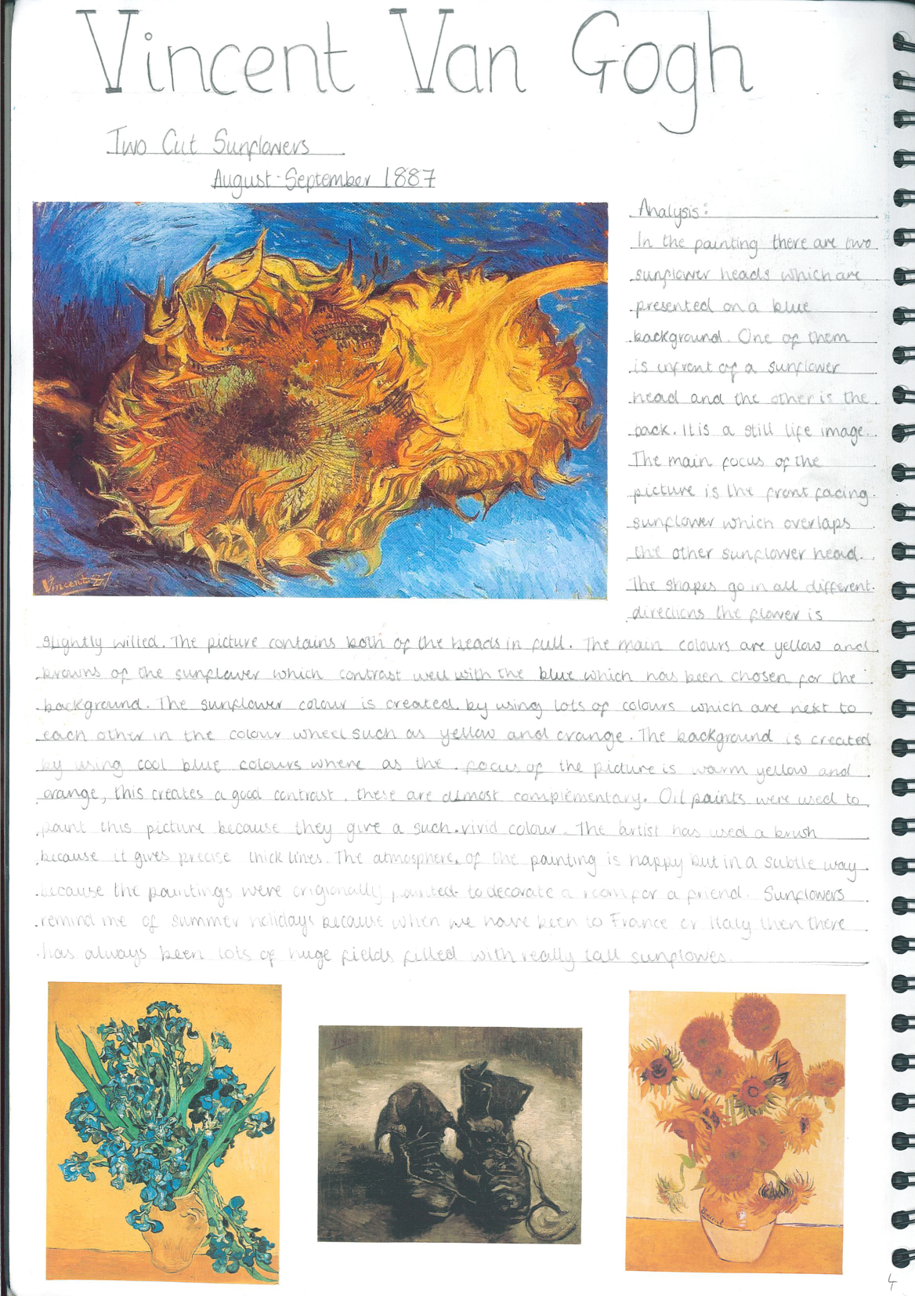
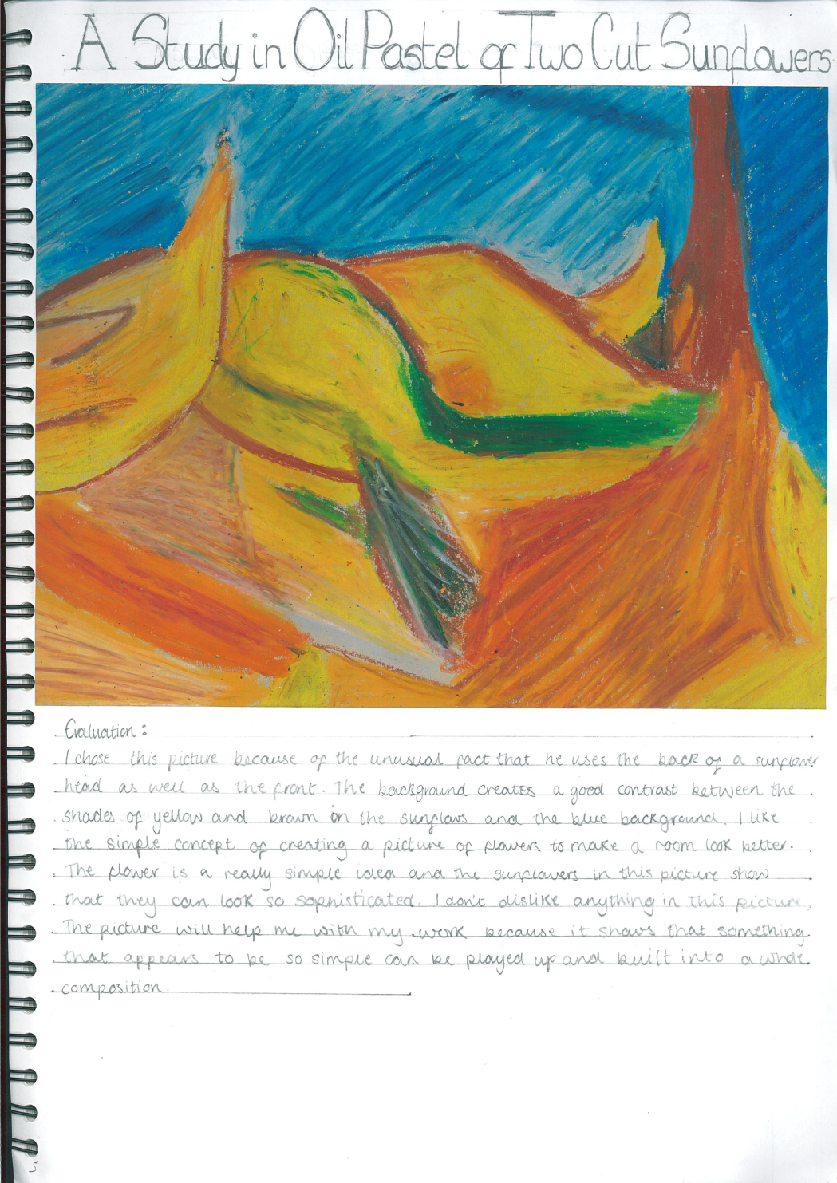
Looking and analysing the work of artists.

Slide 16
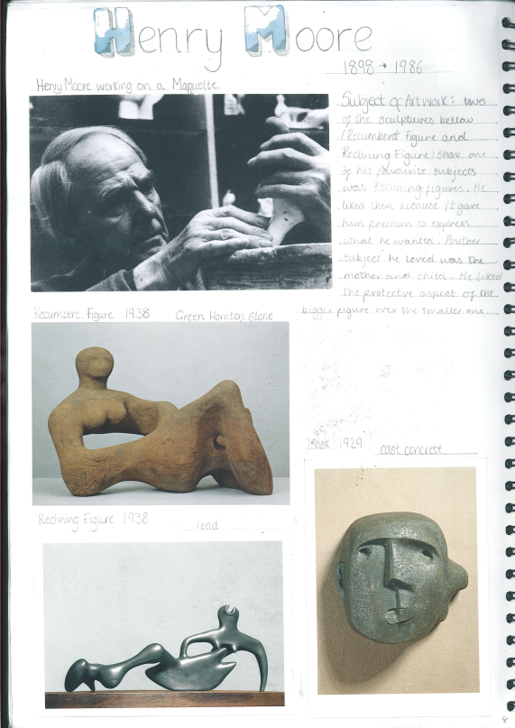
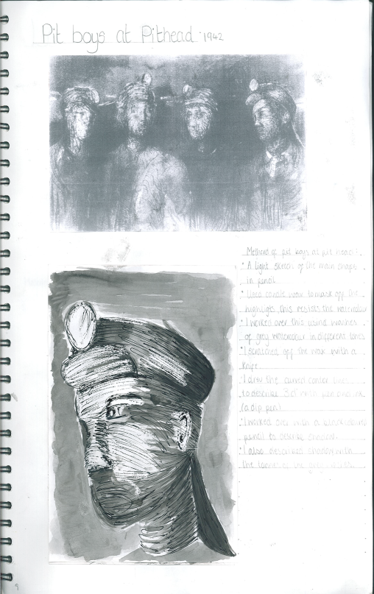
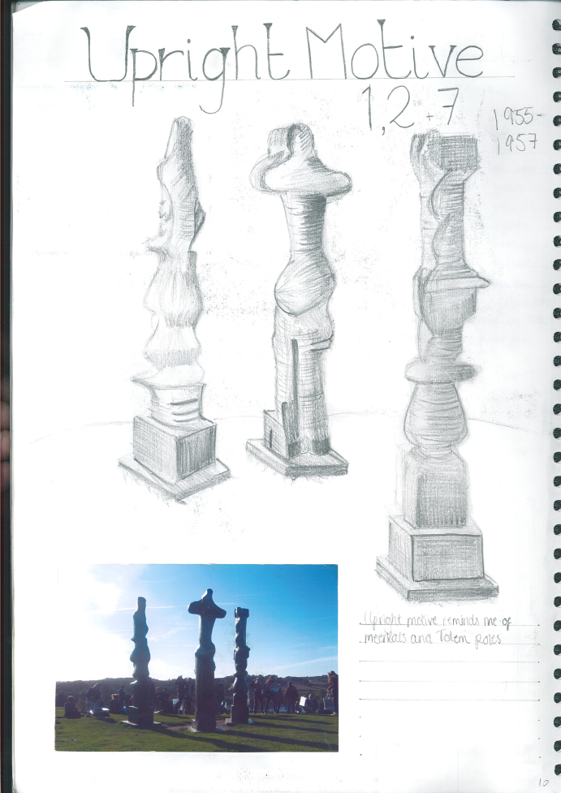
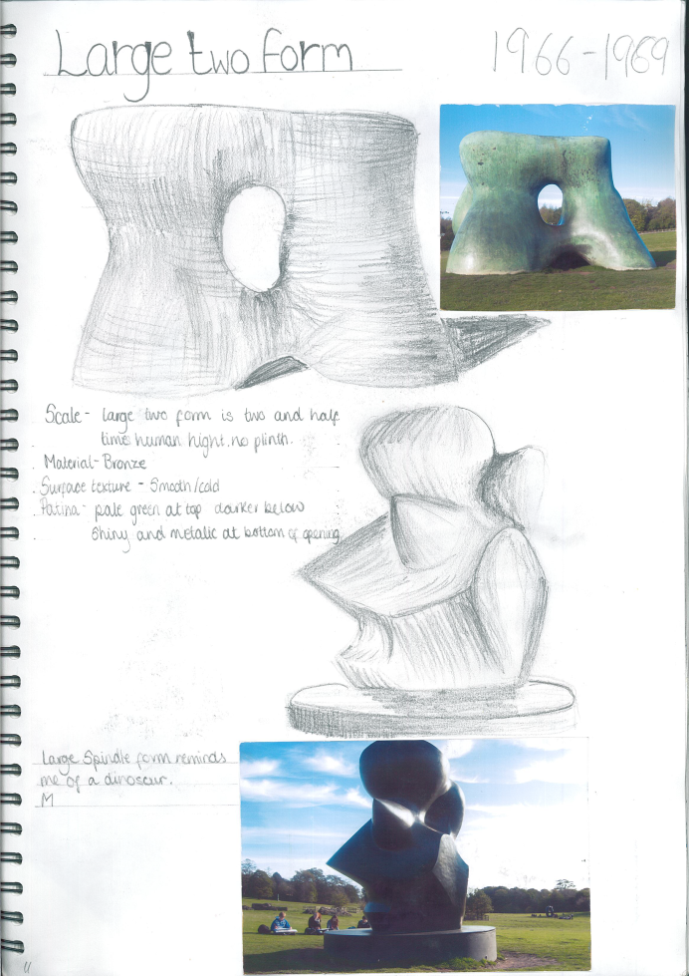
Analysing the work of Henry Moore

Slide 17
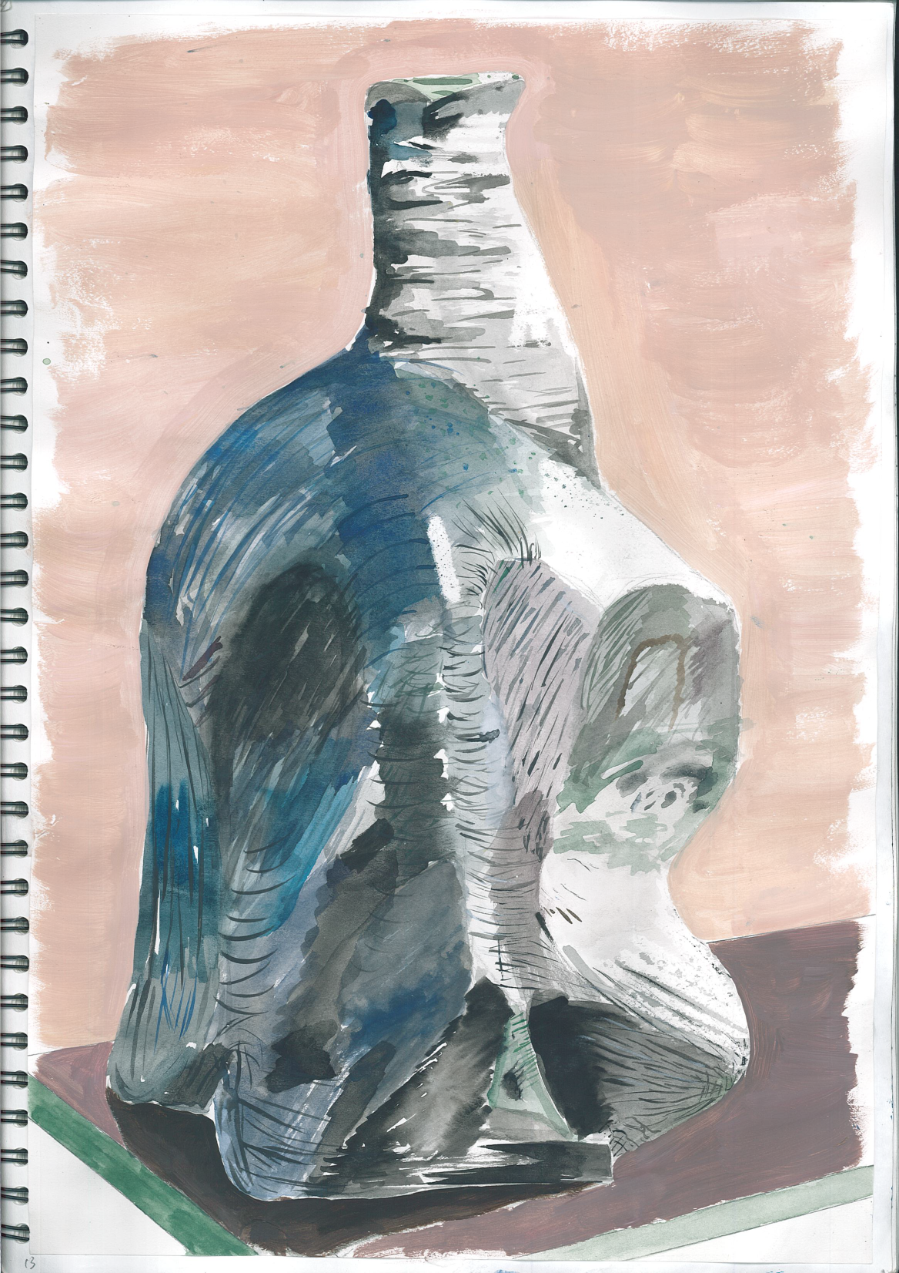
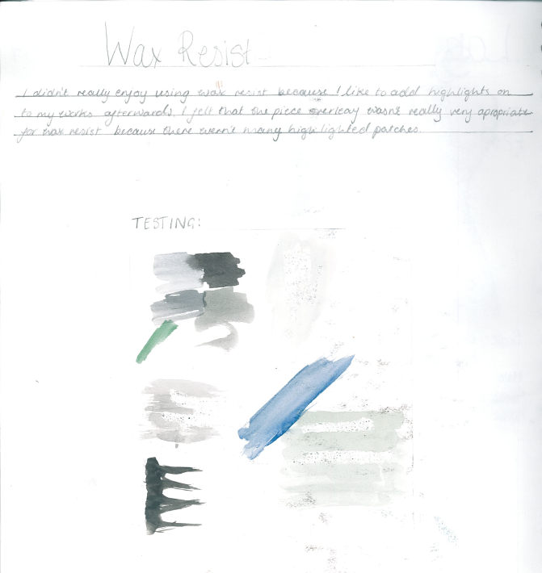
Refining your work by choosing appropriate media

Slide 18
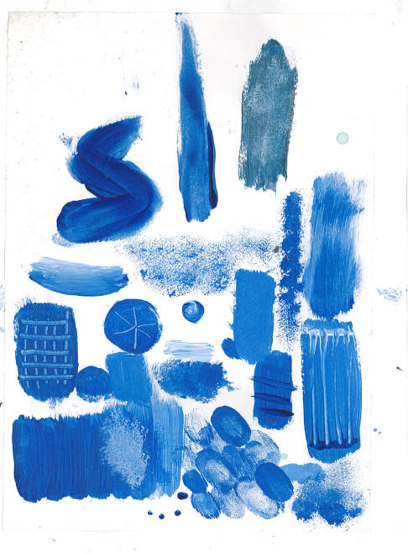
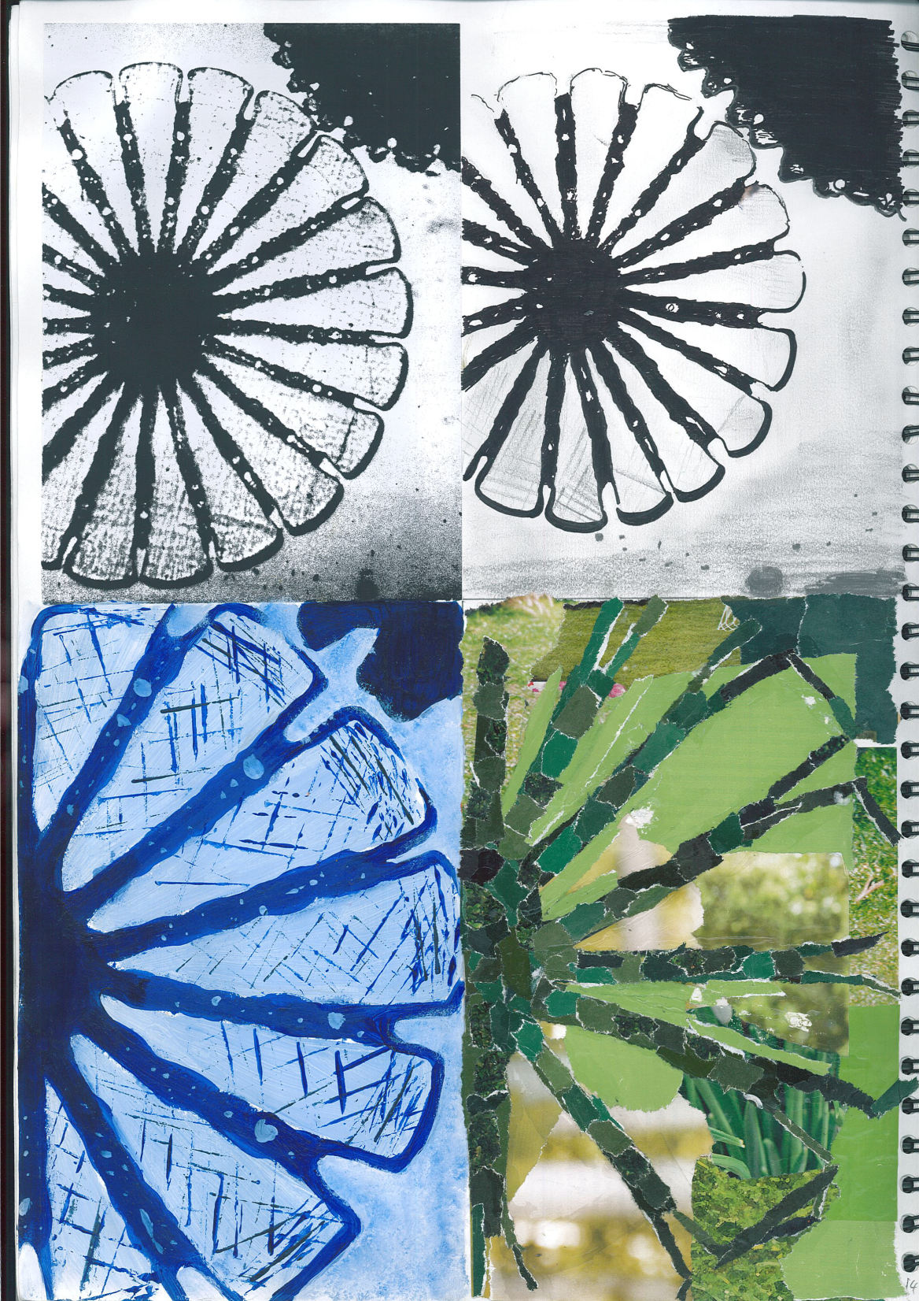
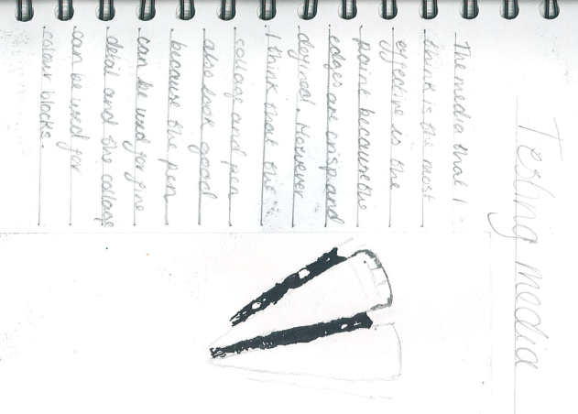
Developing your ideas.

Slide 19
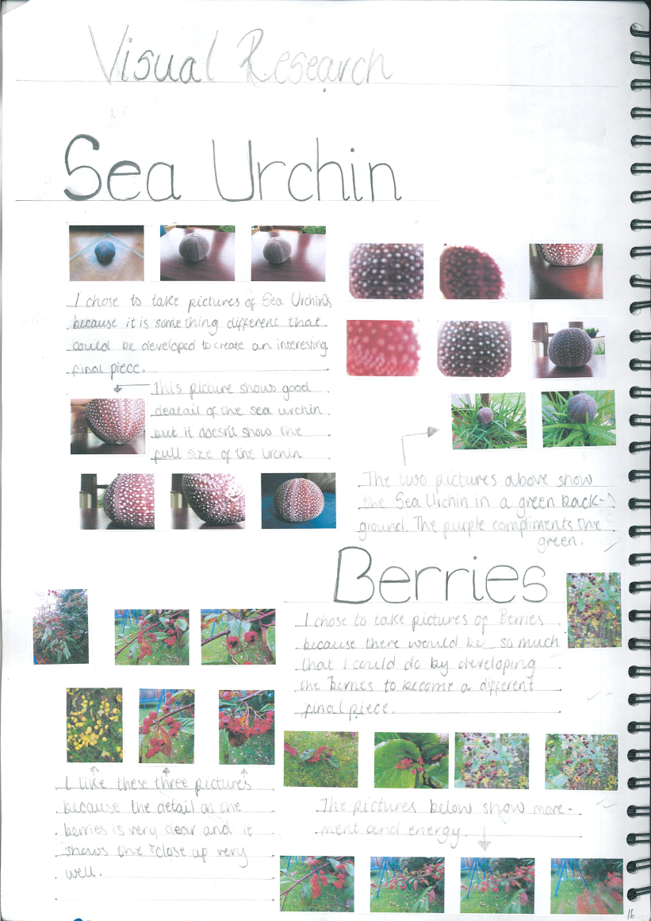
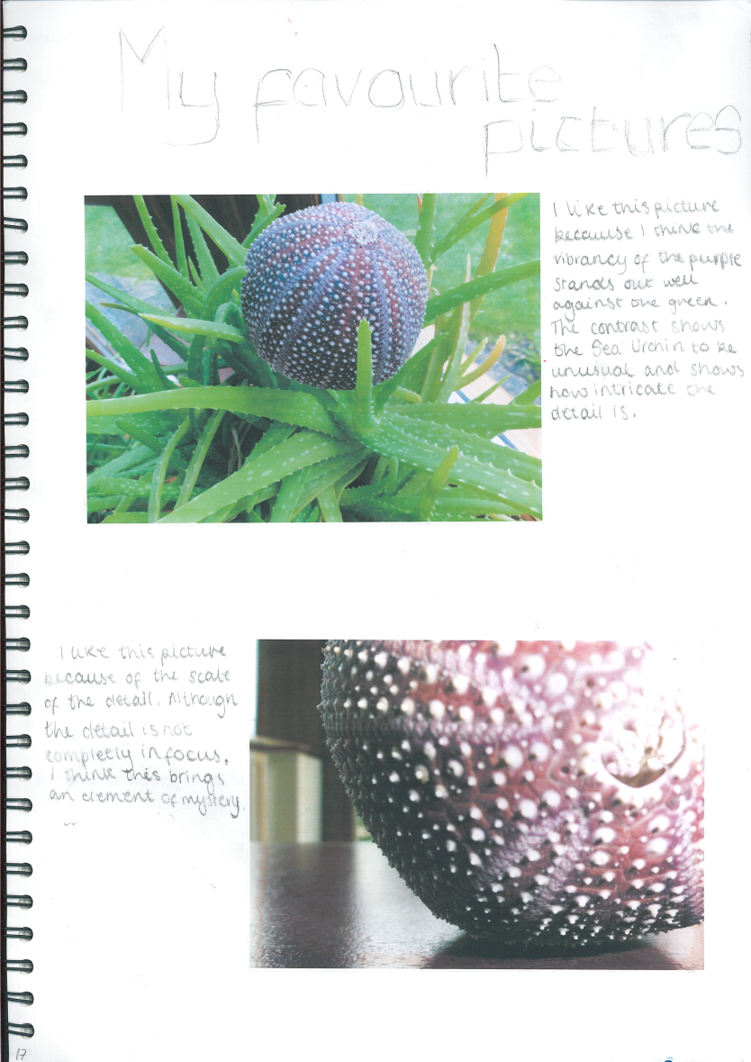
Recording ideas and observations relevant to intentions.

Slide 20
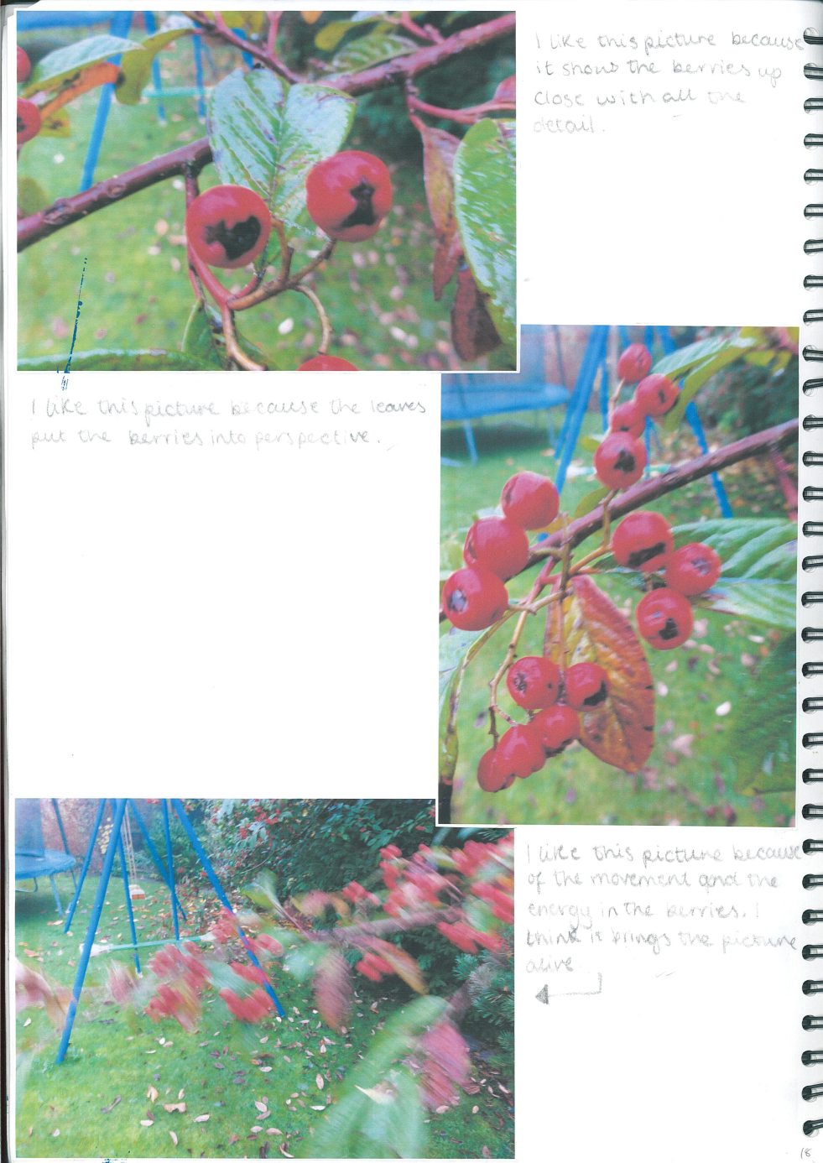
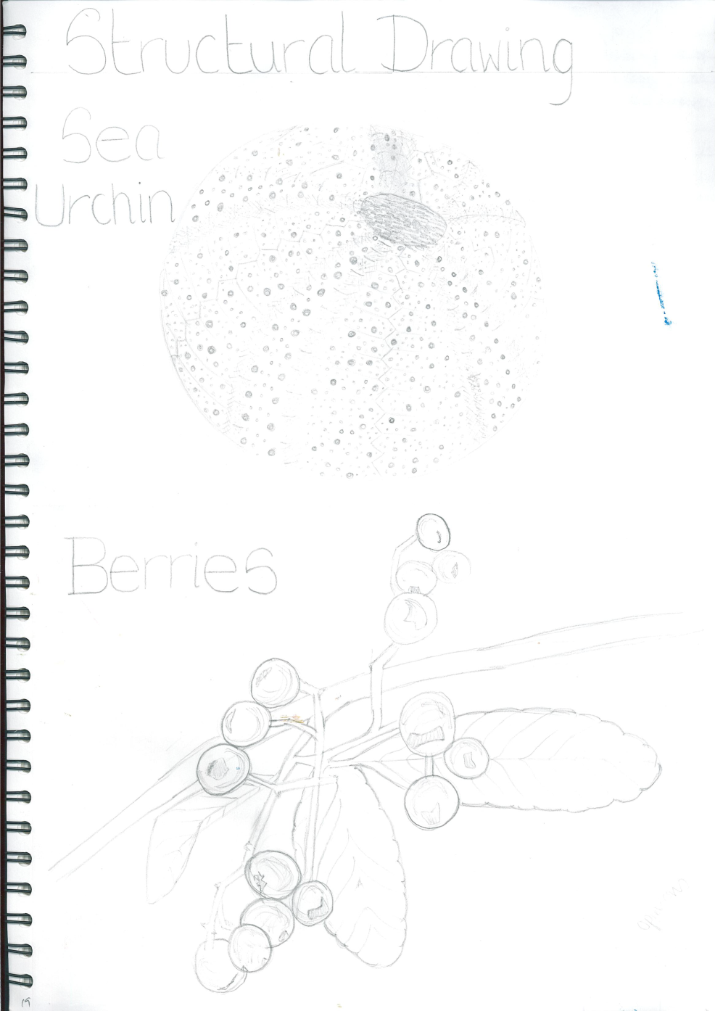
Recording ideas, through photography and observational drawings.

Slide 21
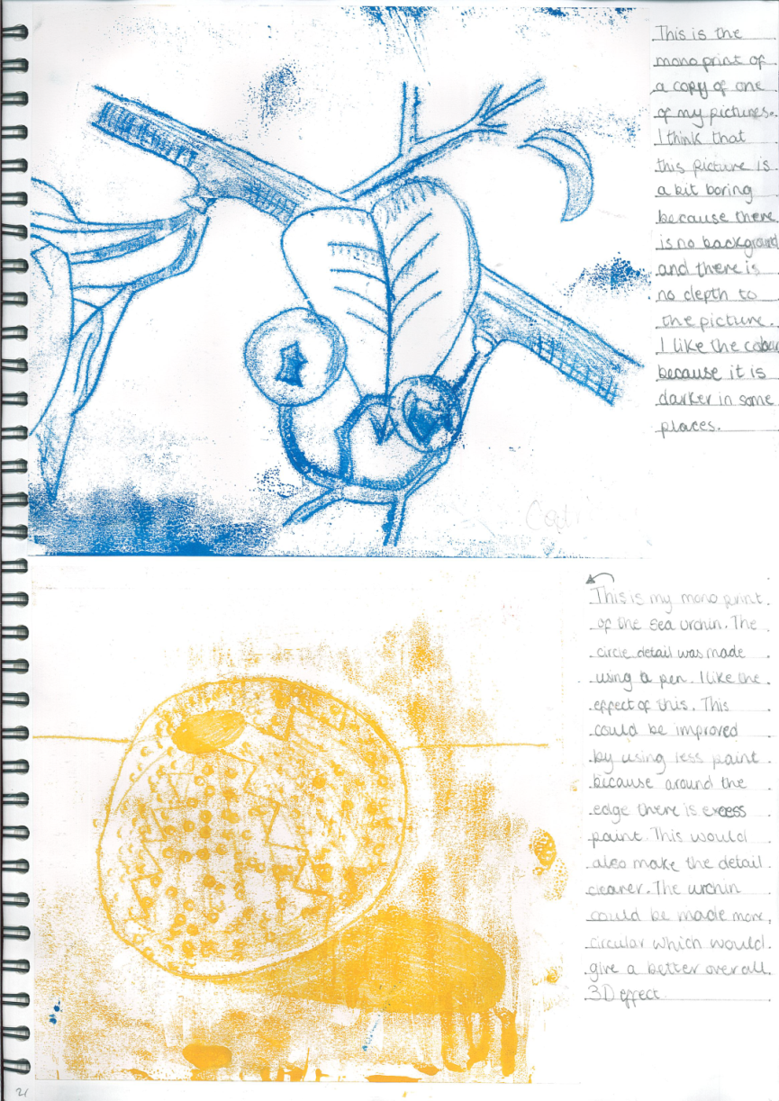
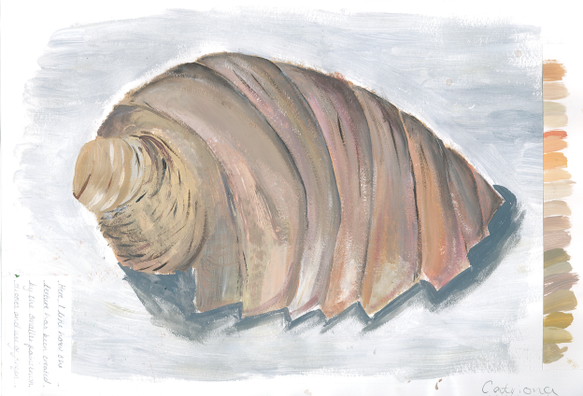
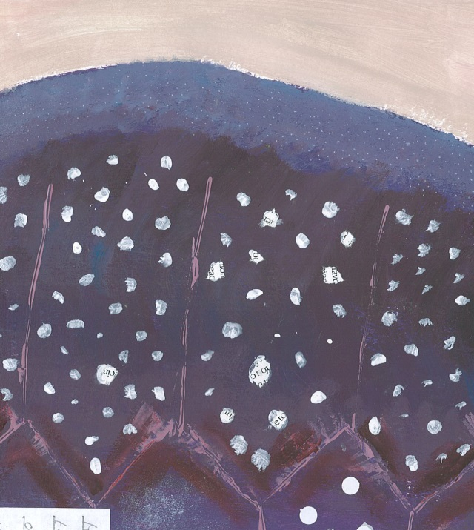
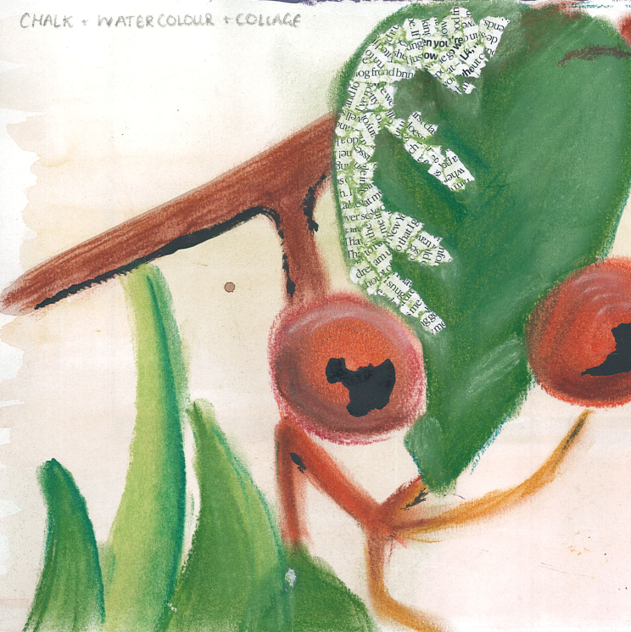
Different media you may use.
Acrylic paint
Mono print
Mixed media: Chalk, watercolour and collage
Acrylic paint and collage

Slide 22
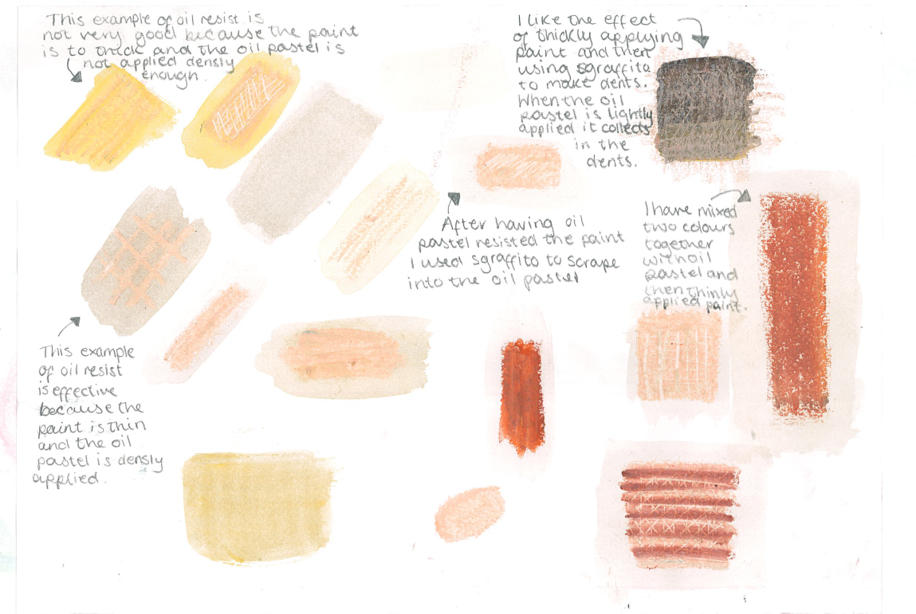
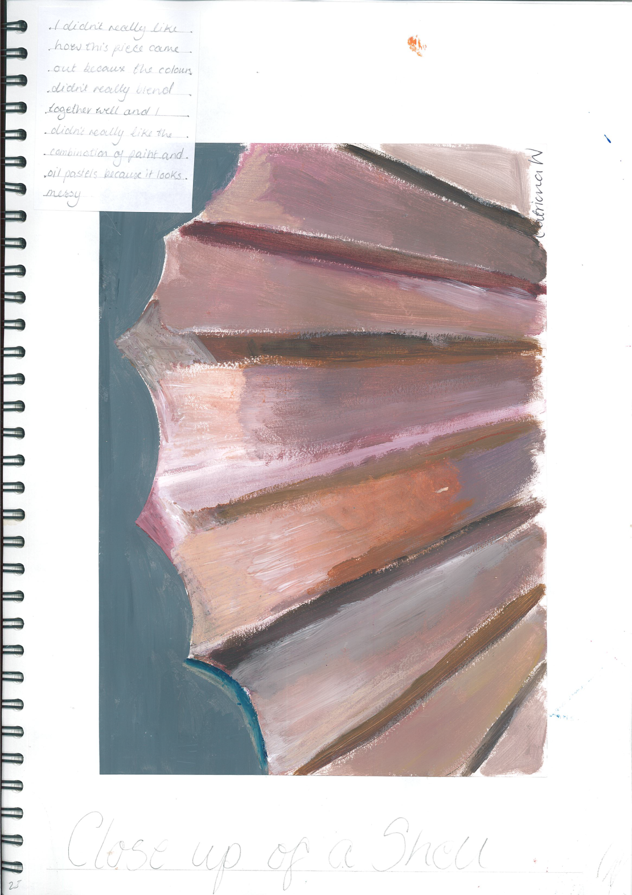
Test page of mixed media
Painting a natural form

Slide 23
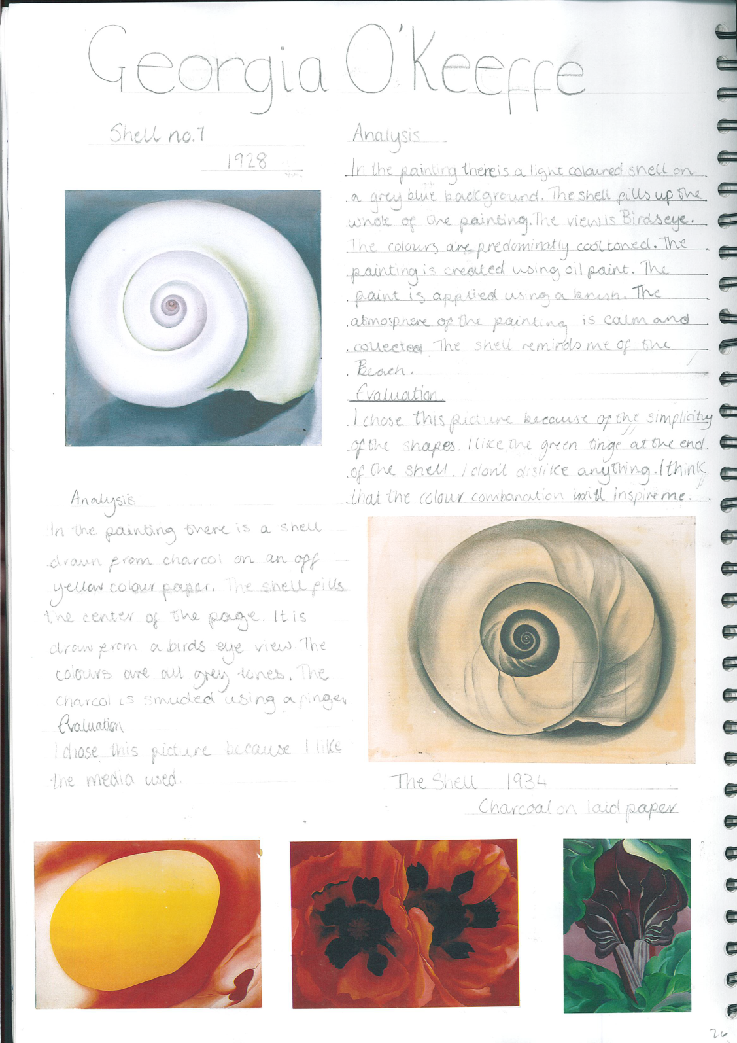
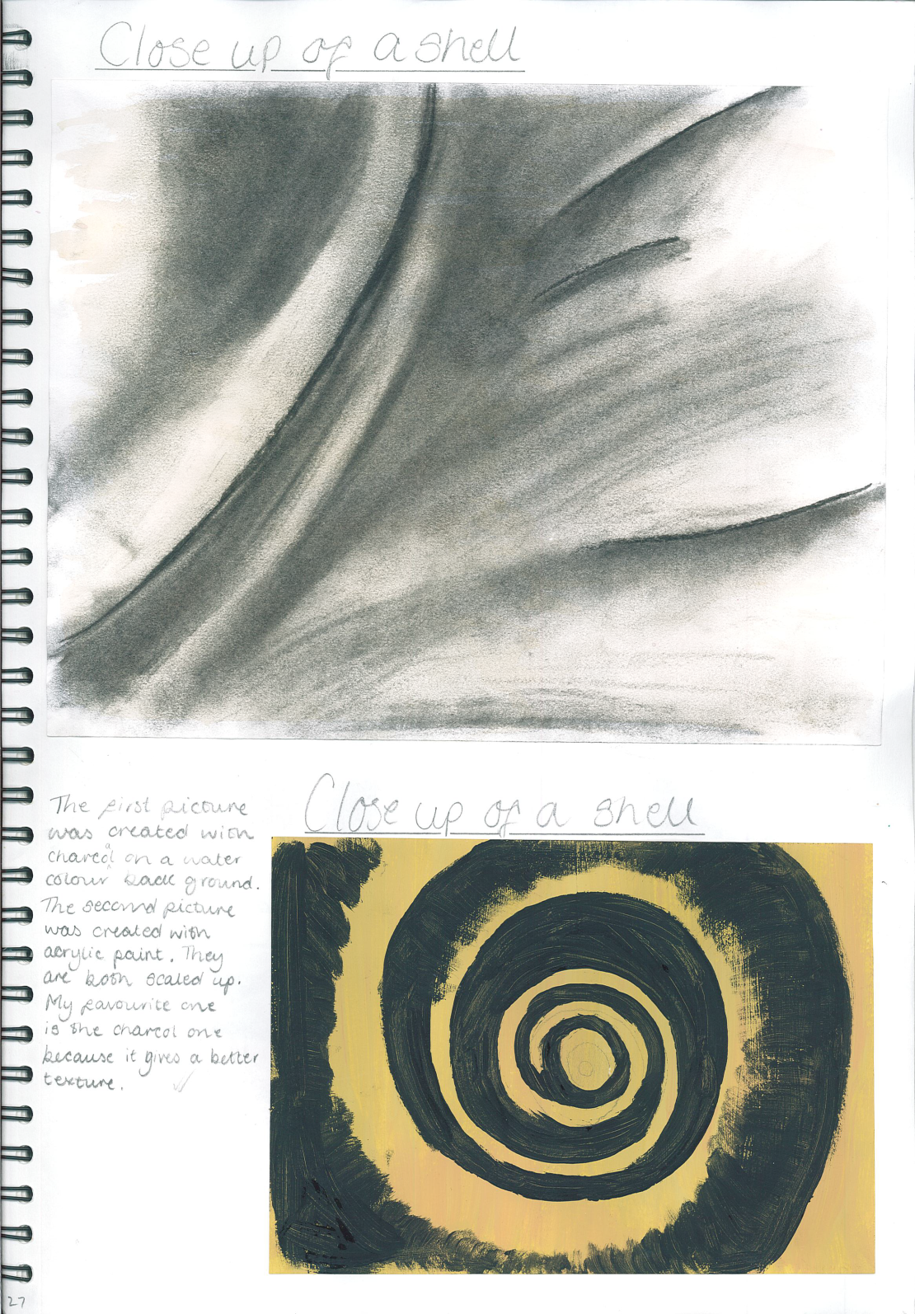
Analysing artists and developing your ideas.

Slide 24
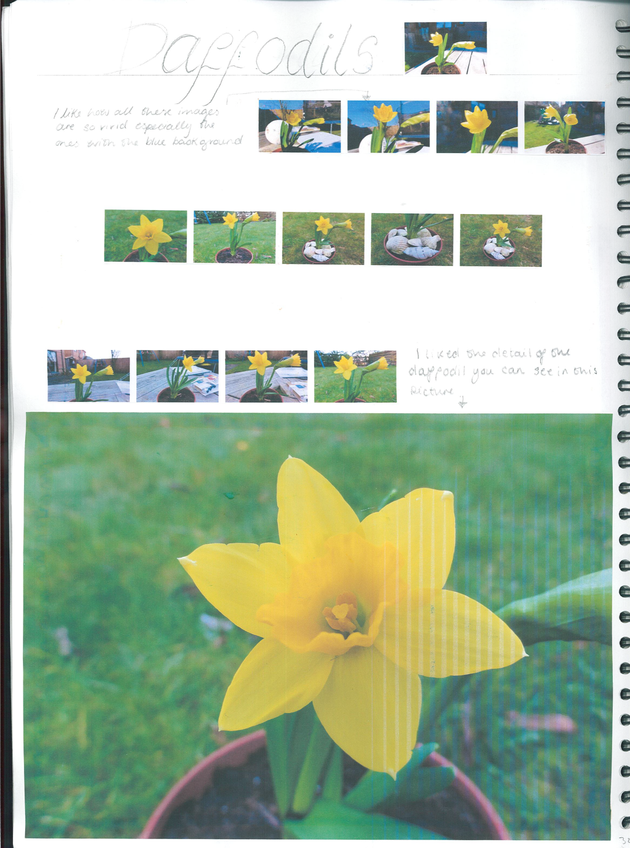
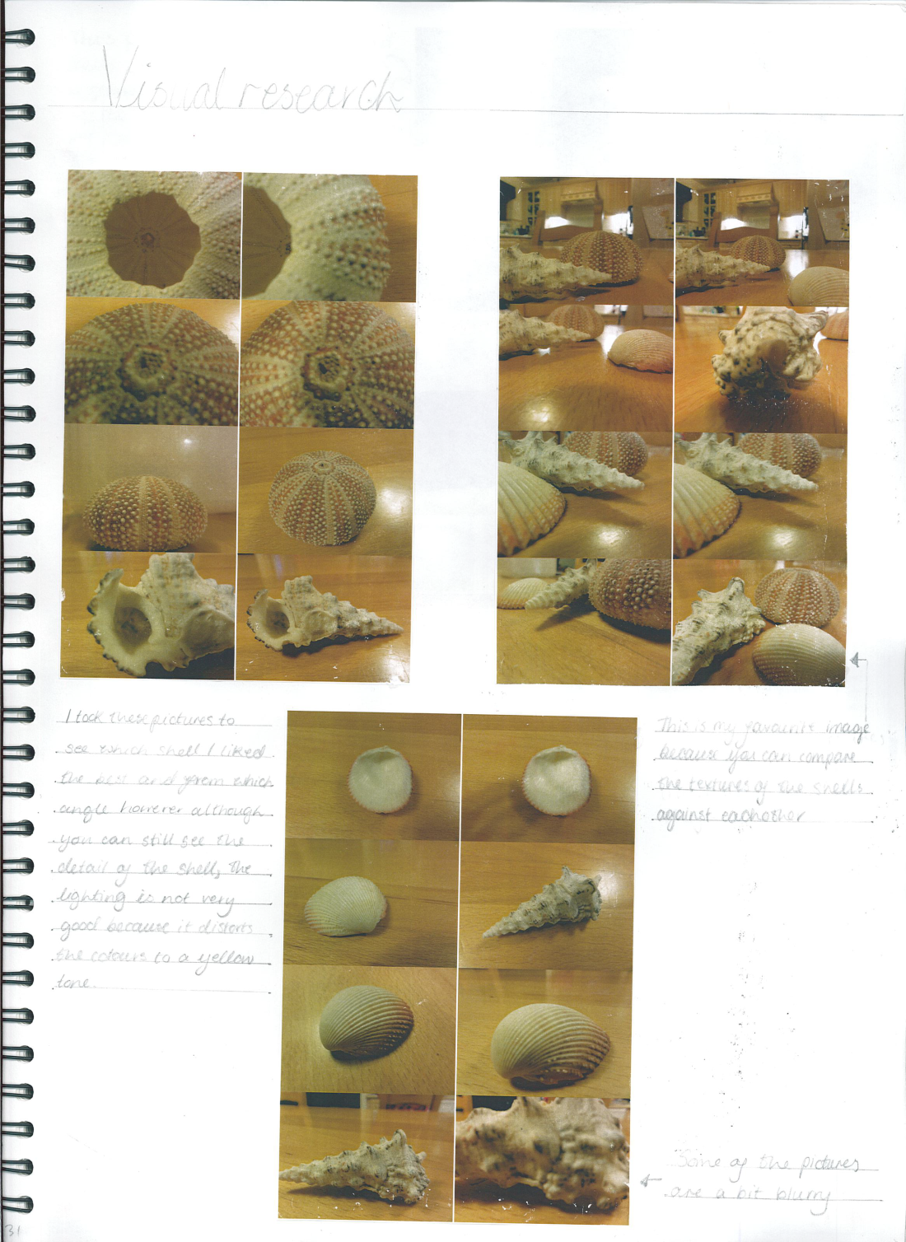
Refining your visual research

Slide 25
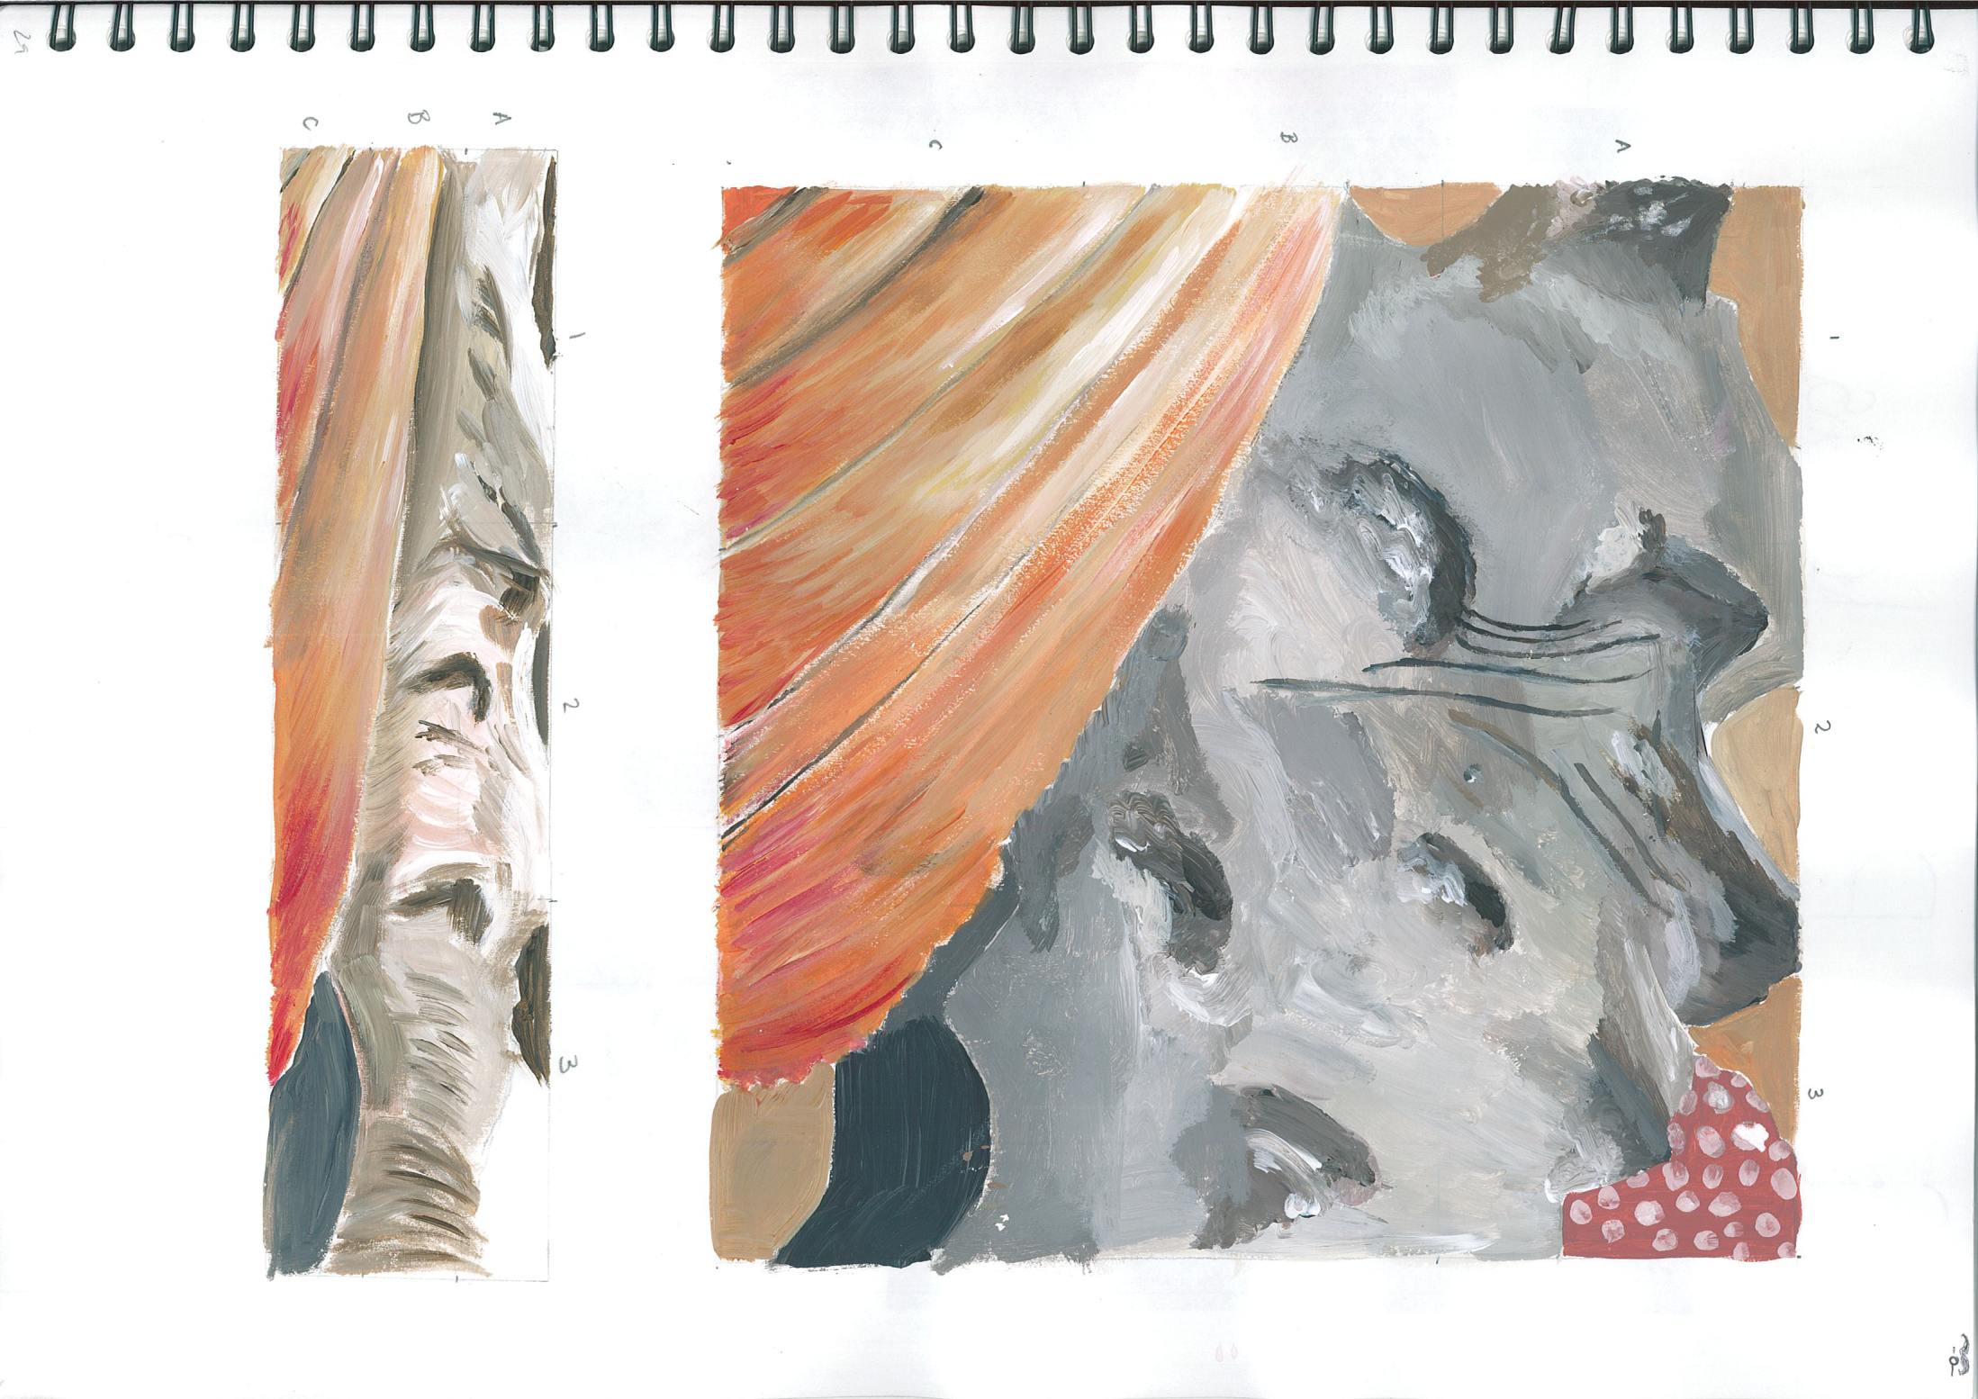
Refining your image by scaling up and stretching, both in acrylic paint.

Slide 26
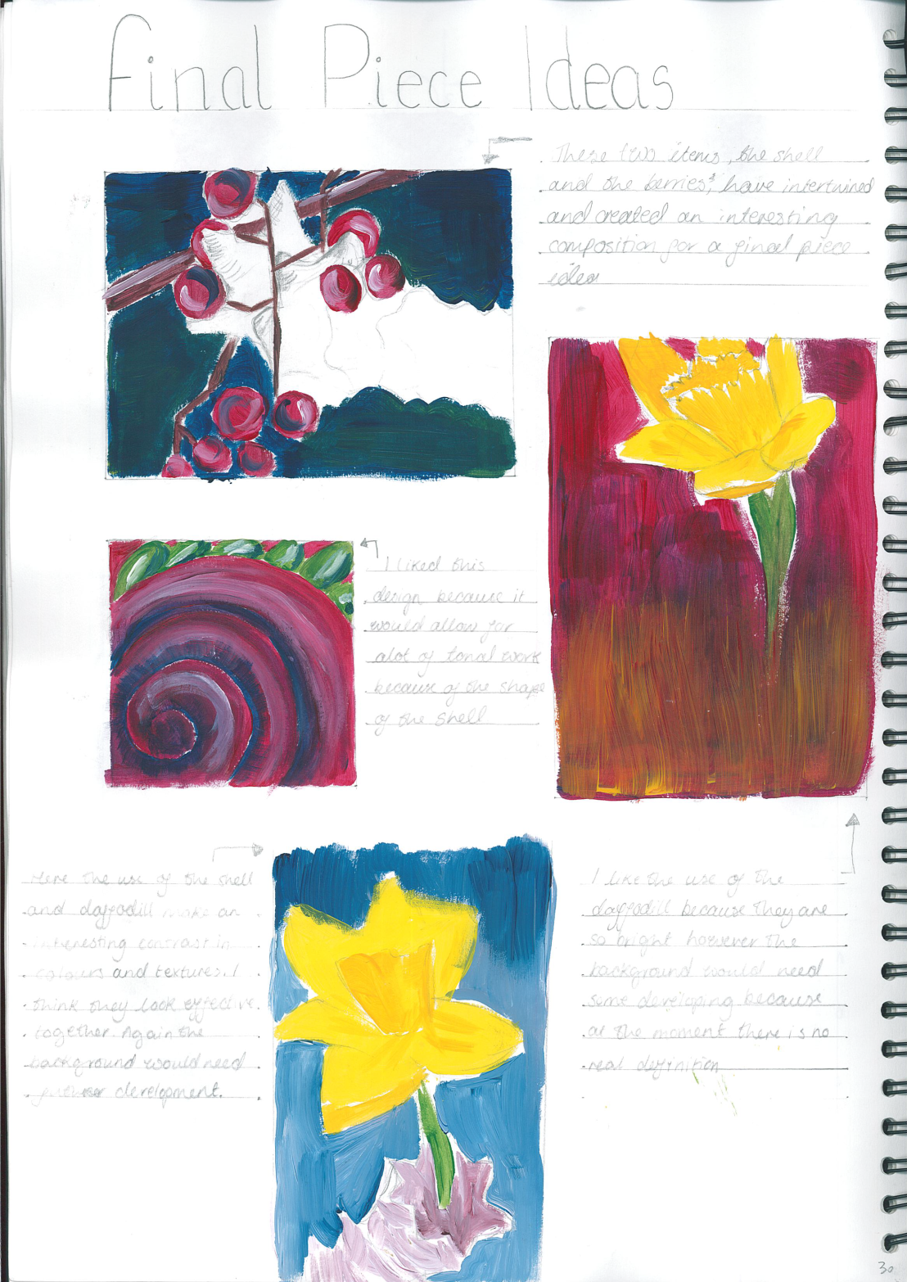
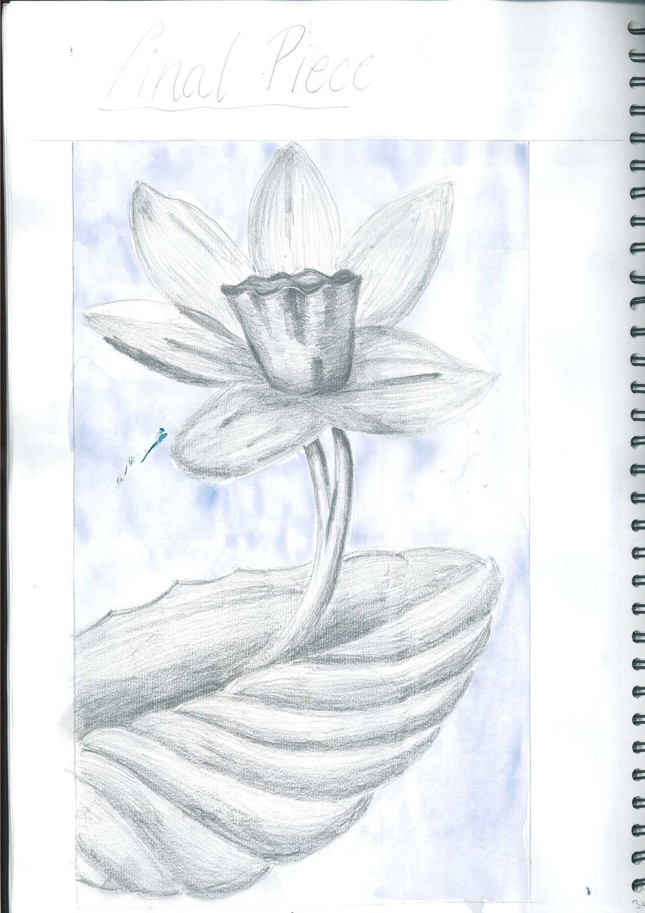

Slide 27
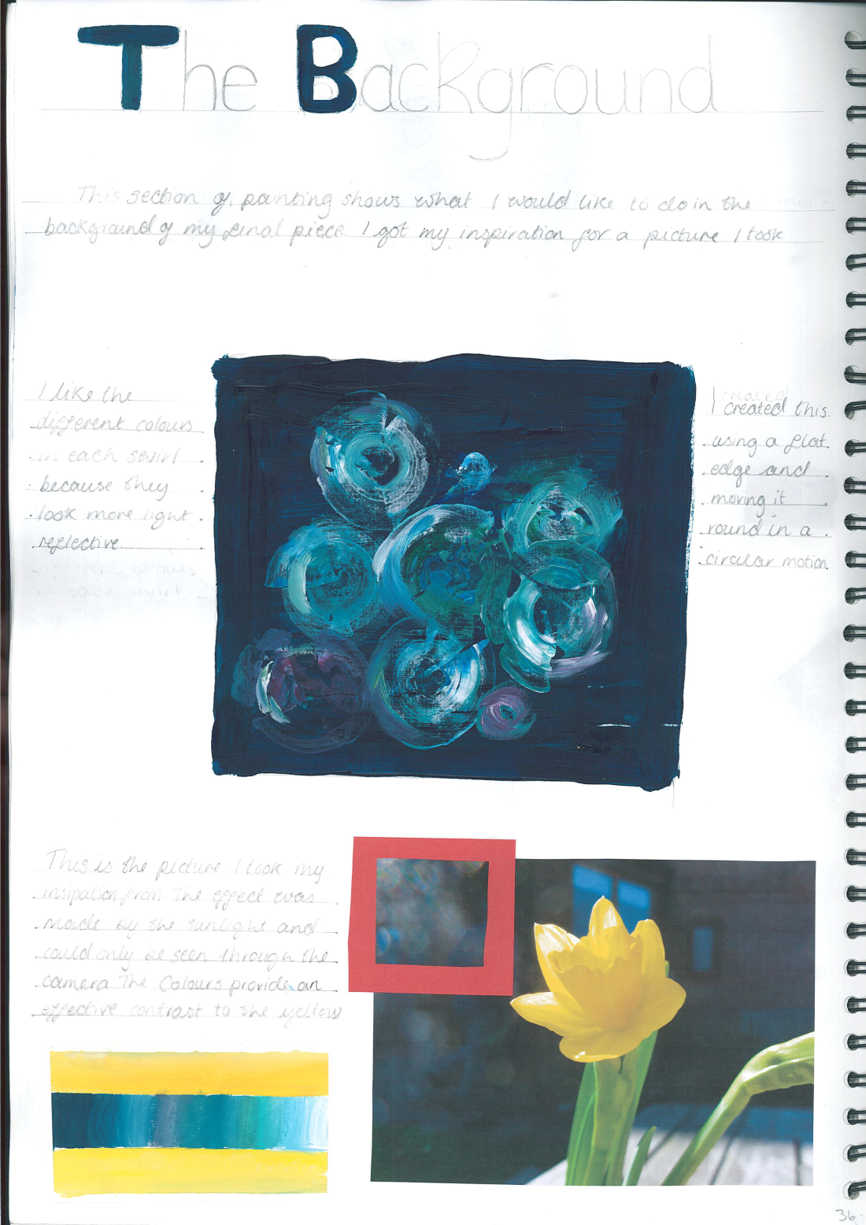
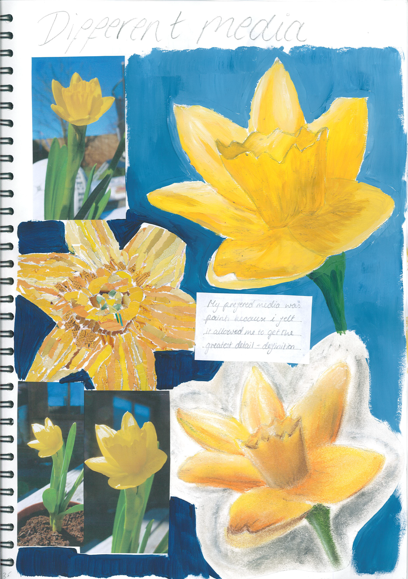

Slide 28
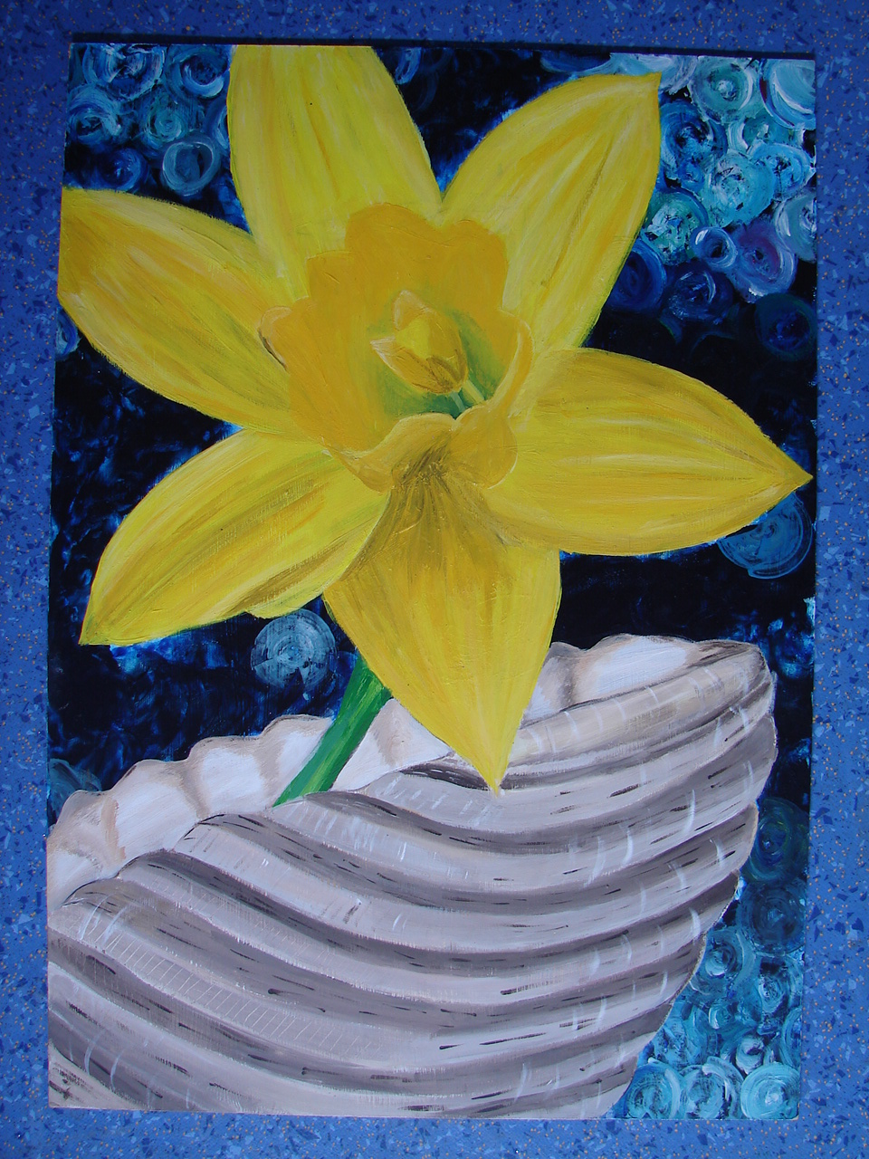
Final piece, acrylic paint,
A2 in size

Slide 29
…don’t take our word for it, here are what previous GCSE students have said about the course…
We think it’s a great
course but…

Slide 30
Reasons for taking GCSE…
I enjoyed the trip YSP.
…more creative than other subjects…
…largely a relaxing and enjoyable GCSE…
…collecting my own images and using different media was very exciting…brought out my imagination.
Brilliant!
Creativity is important in any career.
…you can experiment, it’s more fun.
Very rewarding.
…stimulating.
Gives you freedom, creativity and an opportunity to express yourself.

Slide 31
“It allows you to express yourself”.
I wanted a subject where I could feel a sense of achievement.
I really enjoyed learning about other artists, the one that inspired me the most was Tracy Emin.
One of my best lessons.
…develop my skills and find my own technique.
I’ve also enjoyed playing with different media and trying out new creative ideas.
I used acrylic, ink, dye, sewing, collage, stencilling, pencil, watercolour, clay, mod-roc, relief, frottage, lino print, mono print, wax resist, spray paint.

Slide 32
The exam (10 hours worth)!
I really enjoyed my GCSE exam, it was relaxing and enjoyable committing that amount of time to one piece of work.
Had a lot of advice throughout the preparation which was good.
You don’t have to revise!
Relaxed but productive atmosphere.
It was great to see what everybody in Year 11, taking GCSE, was producing.

Slide 33
Some students are considering careers in art:
Some students had reservations:
I went in to the GCSE course very worried about my technical skill, but I believe I have improved, and there are many different types of media available to use that can suit anyone…
Architect, concept artist for films/games, natural history illustrator, make-up artist, continuing studying at York College, graphic designer, furniture designer, glass, jewellery and silversmithing, interior design, three dimensional design, surface pattern, fashion design, ceramics,

Slide 34
Famous faces who’ve studied Art at GCSE level and /or degree level

Slide 35
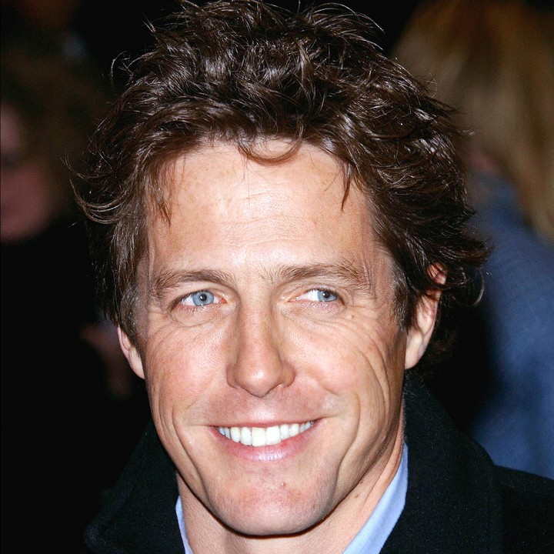
Hugh Grant - actor

Slide 36
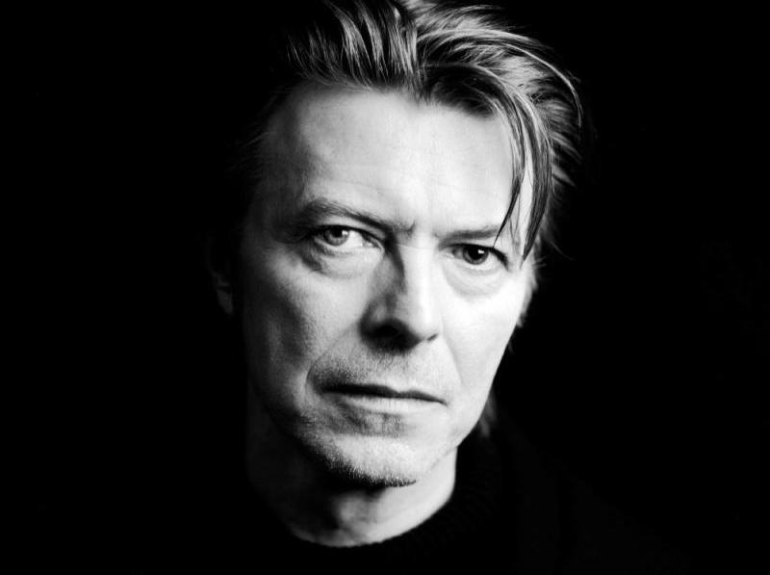
David Bowie
David Bowie –
Musician

Slide 37
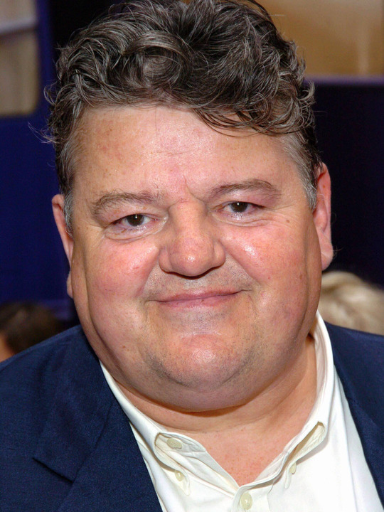
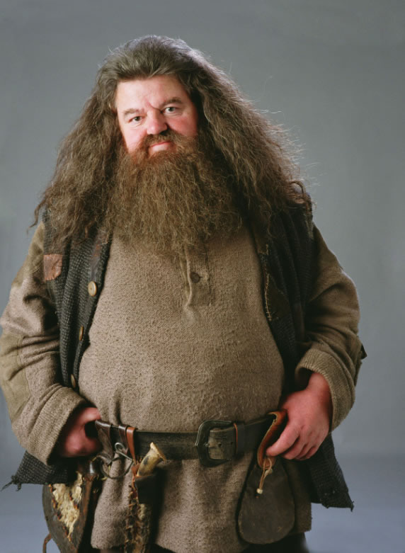
Robbie Coltrane aka Rubeus Hagrid

Slide 38
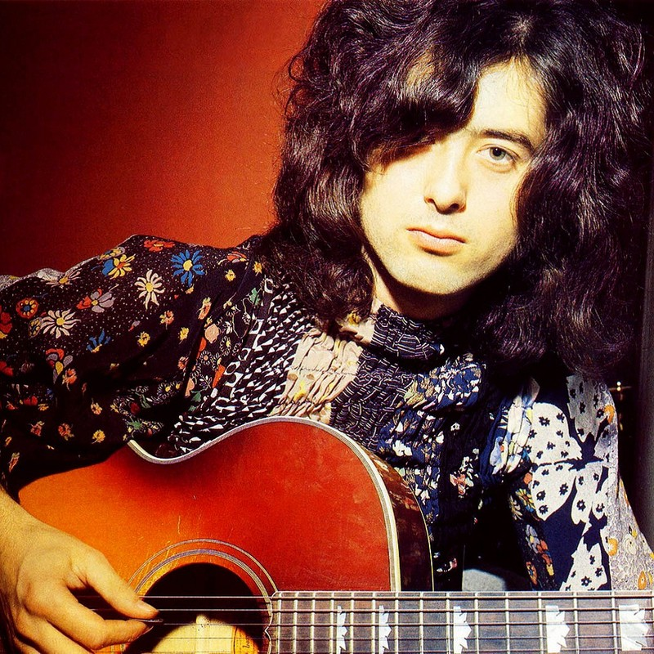
Jimmy Page – guitarist in Led Zeppelin

Slide 39
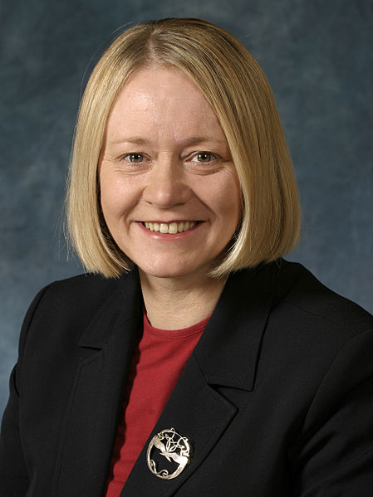
Cathy Jamieson –
Shadow Economic Secretary to the Treasury
(degree level)

Slide 40
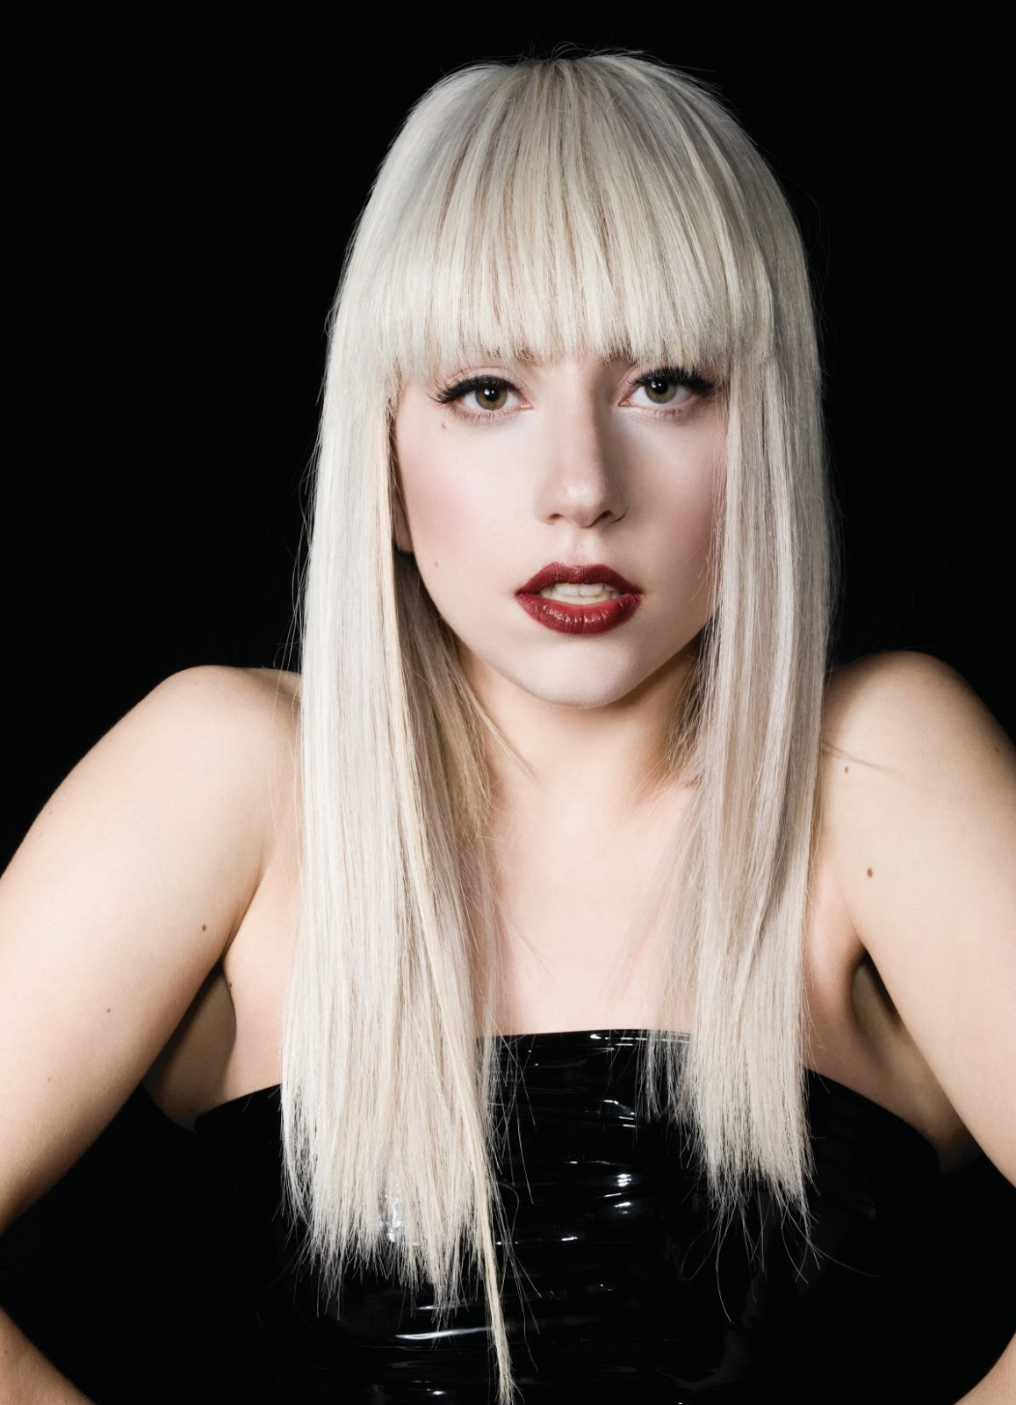
Lady Gaga -
American singer, songwriter, record producer, activist, business woman, fashion designer and actress.

Slide 41
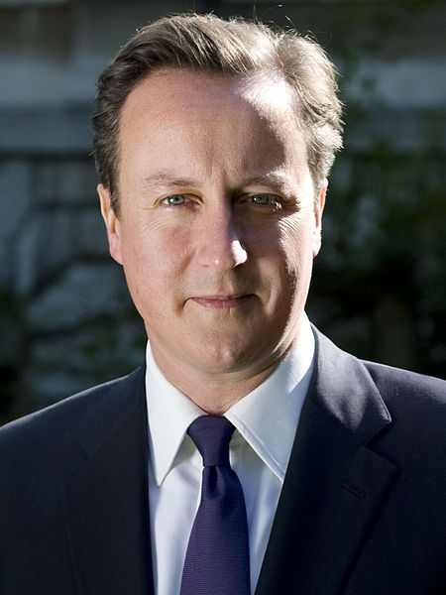
The Right Honourable
David Cameron
Studied the History of Art at A-level

Slide 42
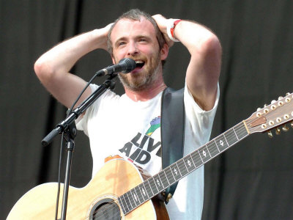
Fran Healy – lead singer in Travis

Slide 43
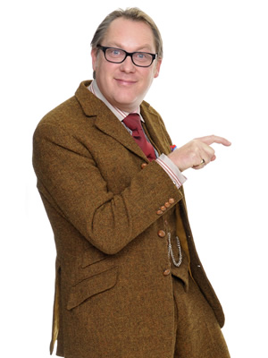
Vic Reeves – comedian and artist

Slide 44
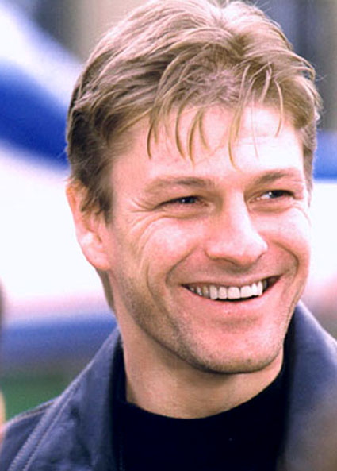
Sean Bean – actor

Slide 45
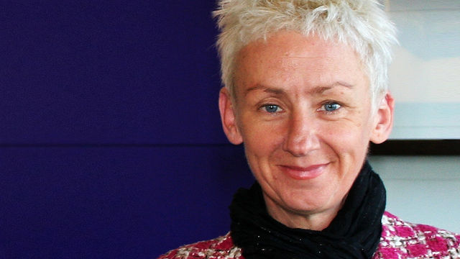
Muriel Gray -
Journalist and Broadcaster

Slide 46
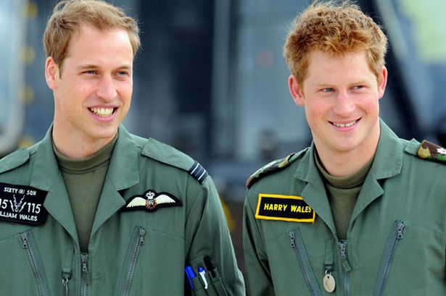
Prince William & Prince Harry

Slide 47
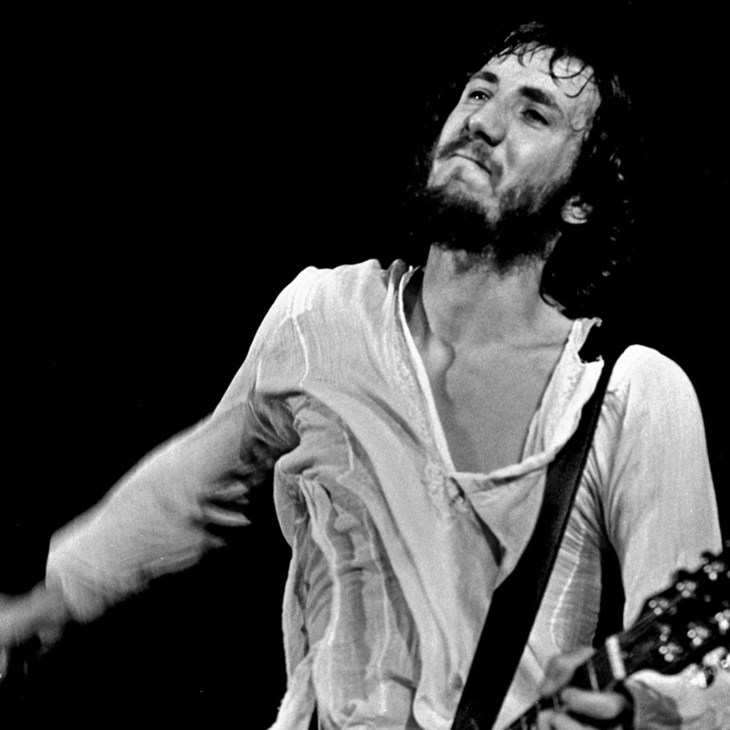
Pete Townsend - guitarist and songwriter for the rock group ‘The Who’.

Slide 48
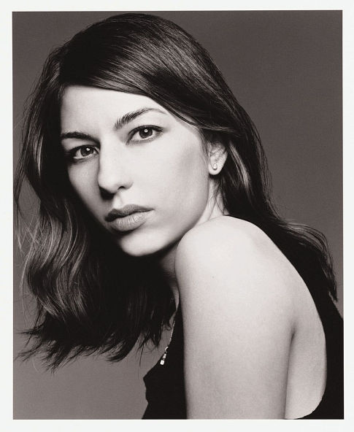
Sofia Coppola – Screen writer, film director, producer and actress

Slide 49
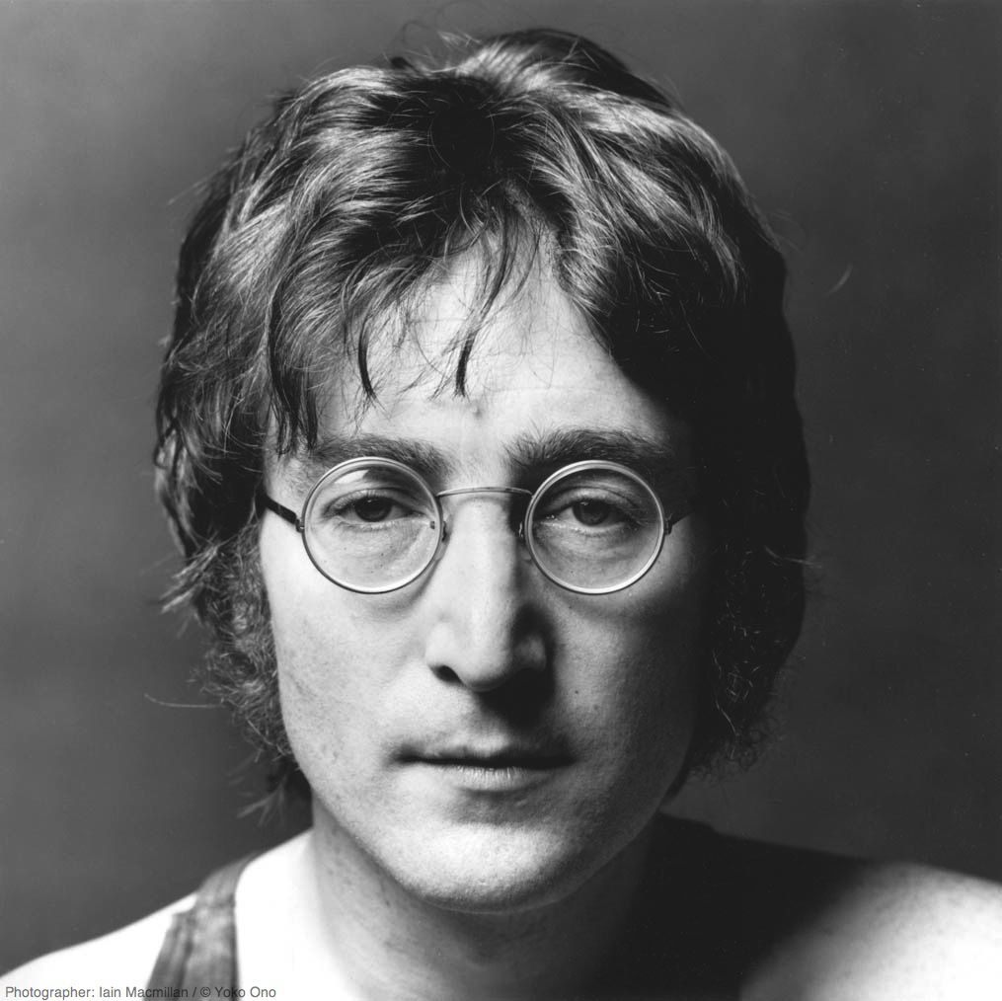
John Lennon – musician, singer and songwriter

