Slide 1
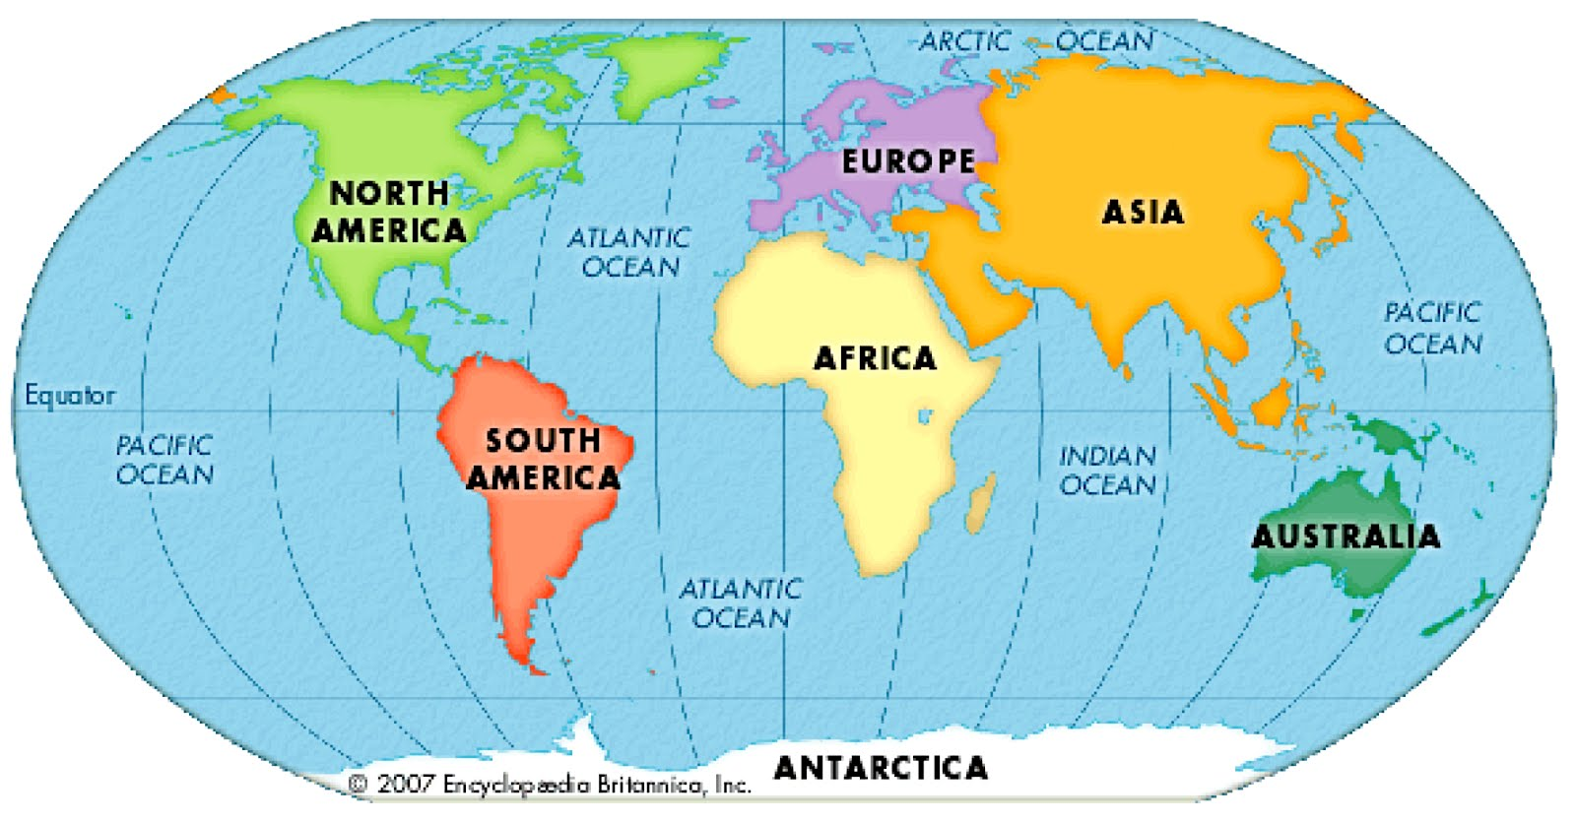
Paper 1: Case studies and Examples

Slide 2
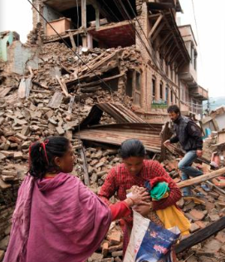
Nepal Earthquake - LIC. 2015.
Primary effect: 9,000 deaths (Kathmandu)
Immediate response: UK search & rescue teams
Secondary effect: avalanches on Mount Everest
Long-term response: stricter building codes

Slide 3
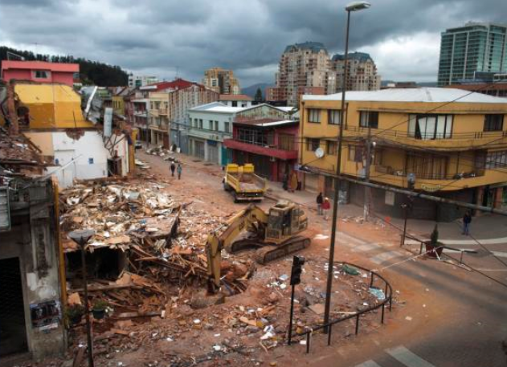
Chile Earthquake - HIC. 2010.
Immediate response: power restored to 90% of homes in 10 days
Primary effect: 500 deaths (Santiago)
Secondary effect: tsunami
Long-term response: housing construction plan

Slide 4
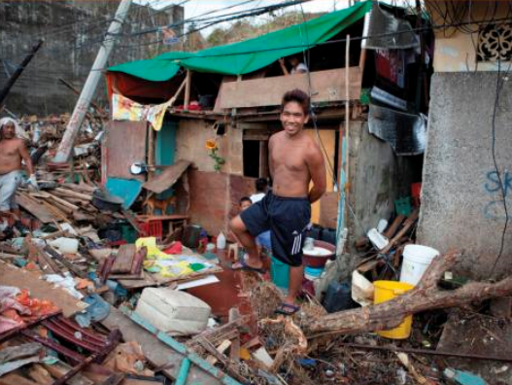
Typhoon Haiyan, Philippines. 2013.
Primary effect: 6,300 deaths (Tacloban)
Immediate response: 1,200 evacuation centres
Secondary effect: 6 million people lost their source of income
Long-term response: built cyclone shelters for protection

Slide 5
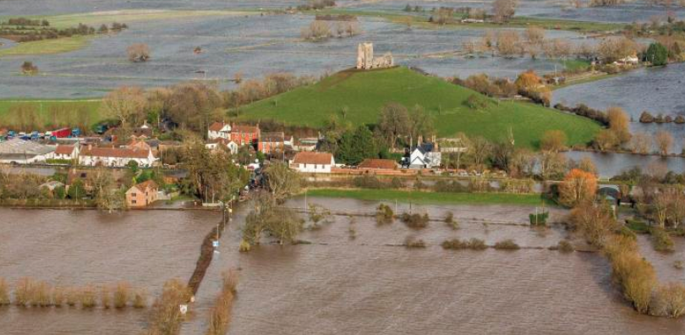
Extreme UK weather: Somerset Levels. 2014.
Immediate response: volunteers used boats to rescue people
Social effect: 600 houses flooded
Economic effect: £10 million damage
Long-term response: £20m Flood Action Plan (raise banks)
Environmental effect: sewage polluted the water

Slide 6
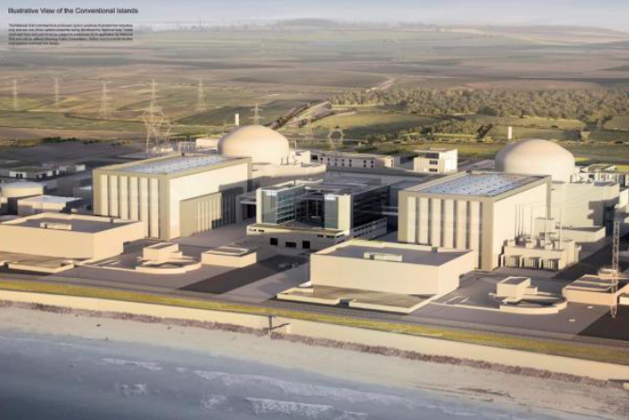
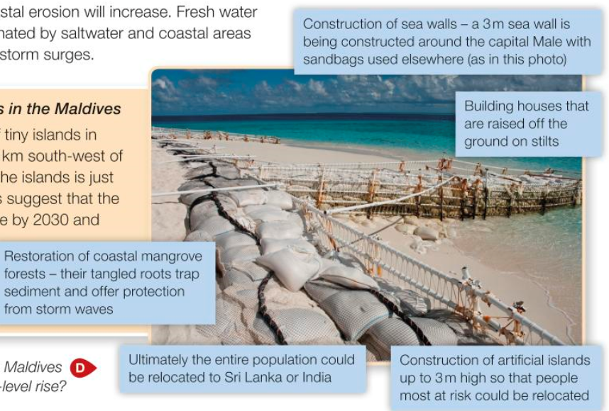
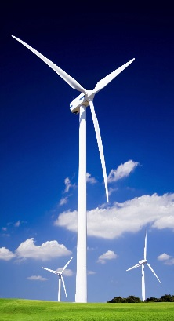
Managing climate change
Mitigation:
Hinkley Point, Nuclear Power
Adaptation:
Sea walls & raising houses in the Maldives

Slide 7
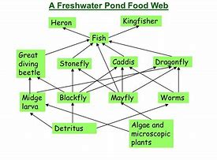
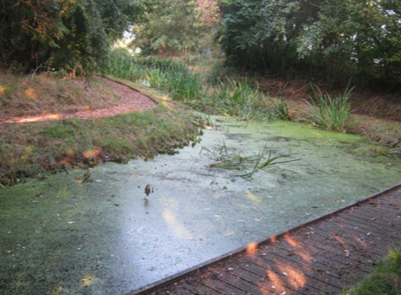
Small-scale ecosystem: Fulford School Pond
Ecosystem change: conservation groups cleared the overgrown vegetation. Short term. Long term.

Slide 8
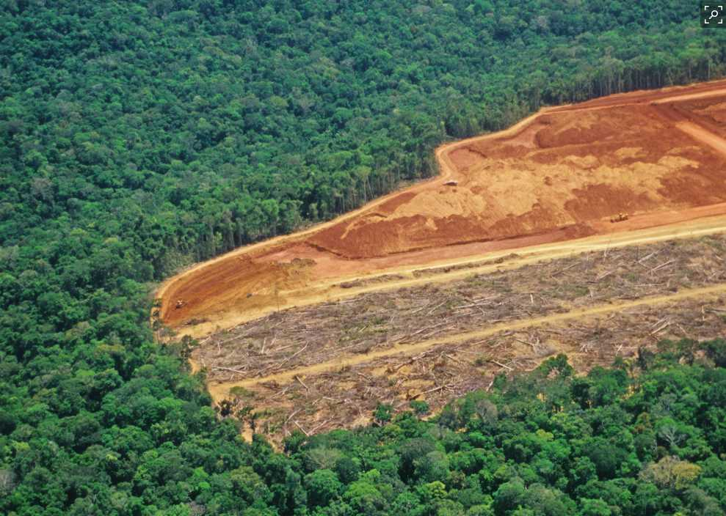
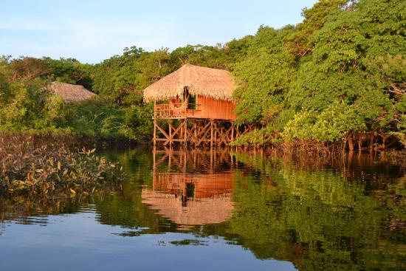
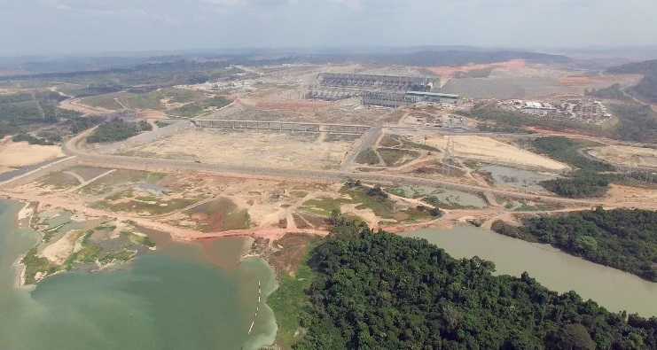
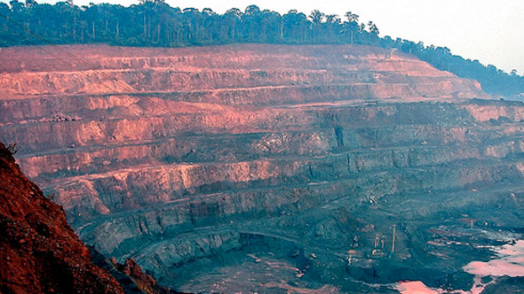
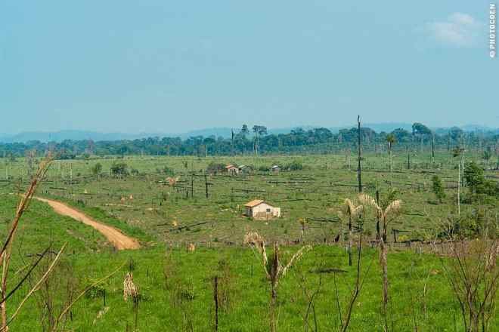
Amazon Rainforest, Brazil
JUMA lodge, ecotourism
Belo Monte Dam
Rondonia Mine & Cattle ranch
Awa tribe

Slide 9
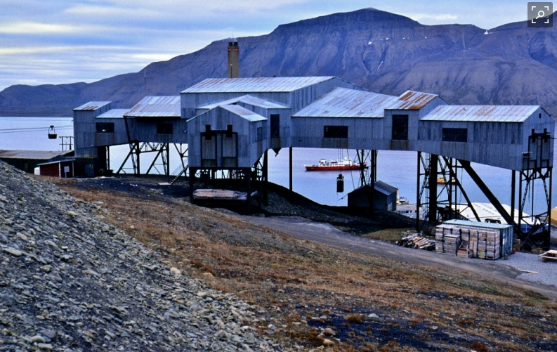
Cold environments: Svalbard
Opportunities:
Svea mine - 300 jobs,
tourism - 70,000/yr to Longyearbyen
power station @ Lyb
fishing - Barents Sea
Challenges:
construction & permafrost
accessibility - 50km roads in Lyb
extreme temp - 30C & limited daylight

Slide 10
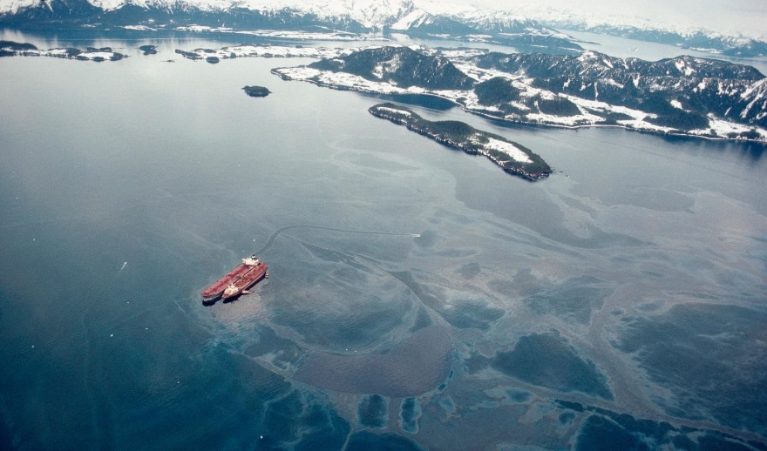
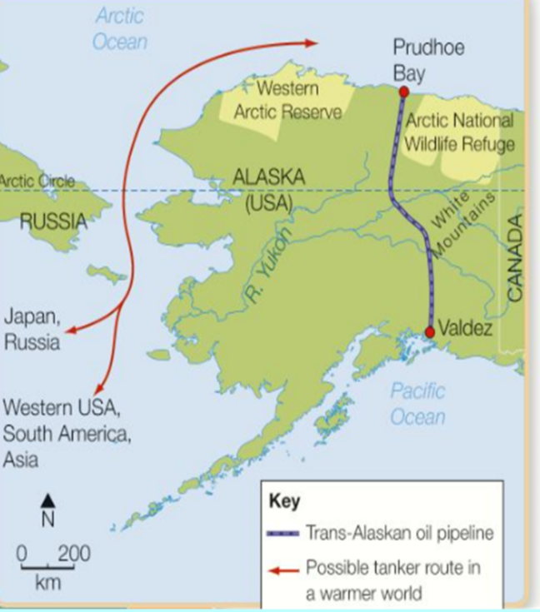
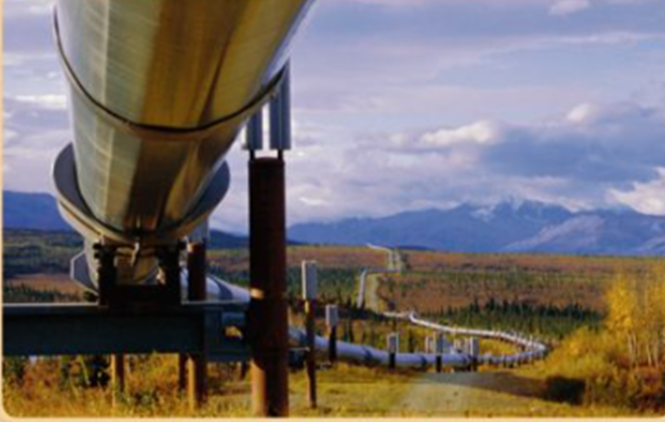
Environmental issues in Alaska
Exxon Valdez, 1989
10 million gallons of oil
Trans-Alaskan Pipeline
4x4 off roading...

Slide 11
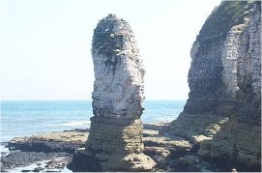
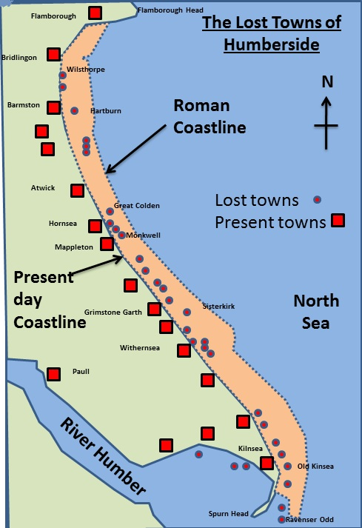
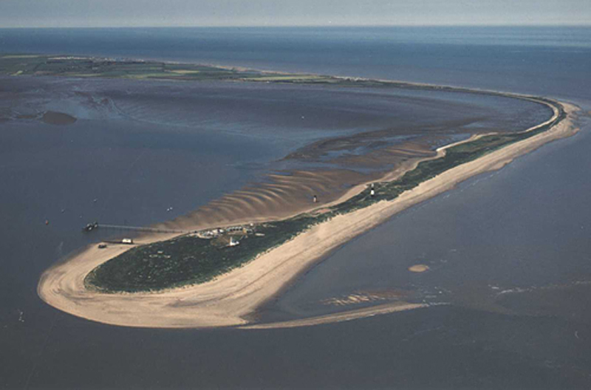
The Holderness coastline: Flamborough to Spurn Head
Longshore drift &
deposition
Spits can join the coast to form a bar e.g. Slapton Ley, Devon

Slide 12
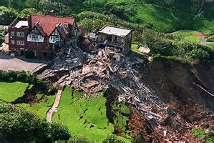
Holbeck Hall, Scarborough,1993
Soft coastline
Rotational slumping
Boulder clay
Mass movement

Slide 13
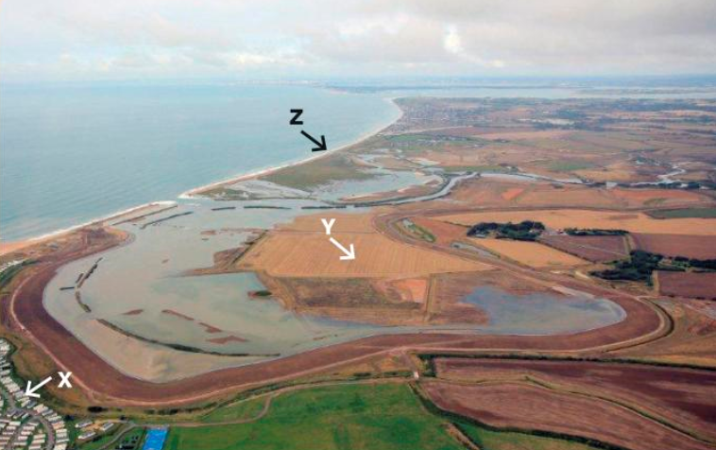
Managed retreat: Medmerry, W.Sussex
Allow land to flood to a point
Saltmarsh develops = more wildlife
Coastal realignment

Slide 14
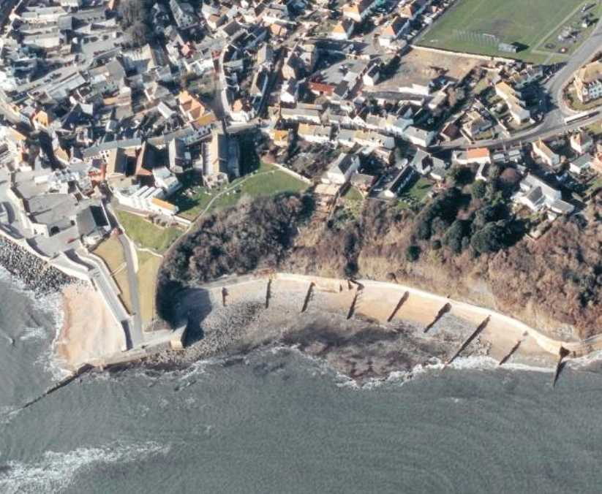
Coastal management: Lyme Regis
Hard engineering:
sea wall
groynes
rock armour
Soft engineering:
beach nourishment
beach reprofiling

Slide 15
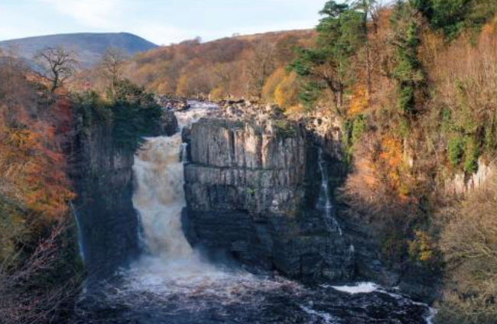
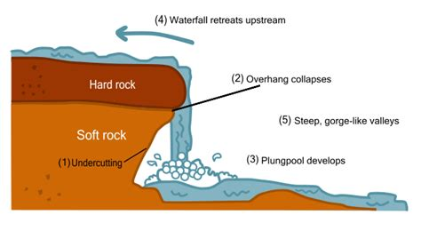
River landforms: River Tees
High Force

Slide 16
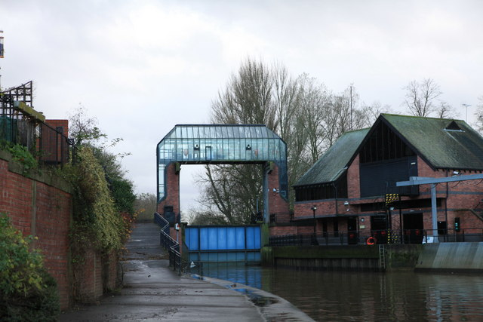
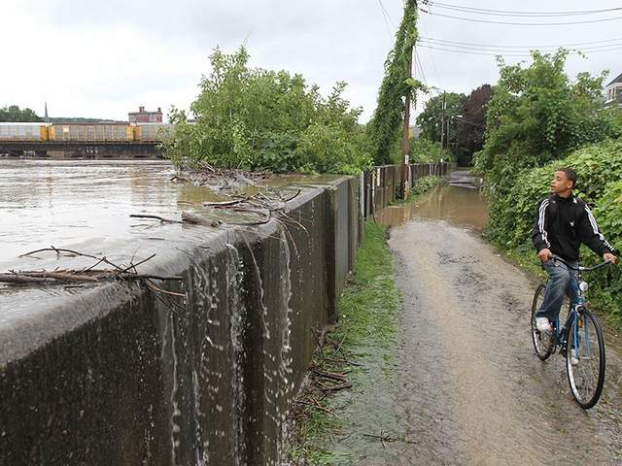
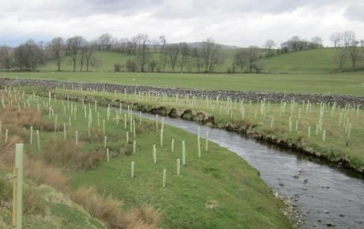
Flood management: River Ouse, York
Hard engineering:
Foss Barrier
Floodwalls
Soft engineering:
Tree plantations in the Yorkshire Dales

Slide 17
Paper 2: Case studies and Examples

Slide 18
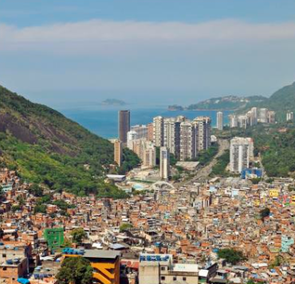
City in a LIC or NEE: Rio de Janeiro, Brazil
2016 Olympics
Social challenges & opportunities: health, education, housing, water.
Banking services
Chemical industries
Economic challenges & opportunities: unemployment / employment
Tourism & beaches
Rocinha - favela, 100,000

Slide 19
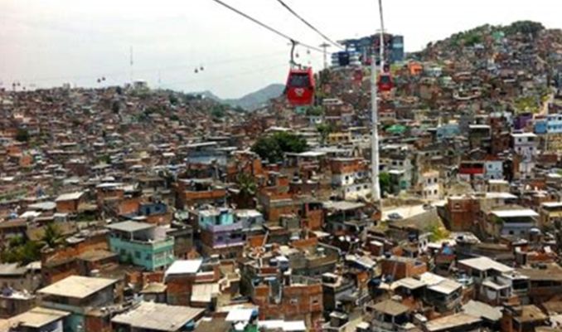
Planning to improve lives of urban poor: Favela Bairro Project, Rio
Successes: Improved water supply
New health & education services
Cable car
Problems:
$1bn not enough
Residents still lack skills
High rent

Slide 20
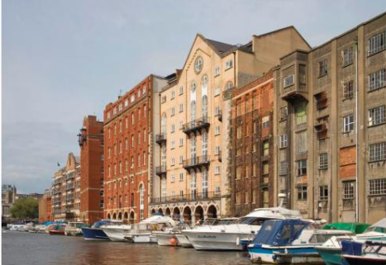
Major city in the UK: Bristol
Dereliction
Investment e.g. BMW & Airbus
Finance / hi-tech industries
Airport
Inward migration = +/-
Brownfield sites
Urban sprawl
Urban greening
Opportunities & challenges

Slide 21
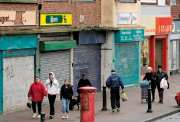
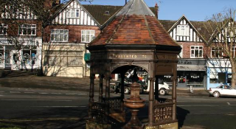
Deprivation and inequalities in Bristol
Filwood (deprived)
Stoke Bishop (affluent suburb)

Slide 22
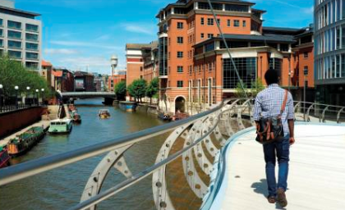
Urban regeneration: Temple Quarter, Bristol
Engine Shed (hi-tech businesses)
Enterprise Zone
New bridge across River Avon
Bristol Arena (£90m)

Slide 23
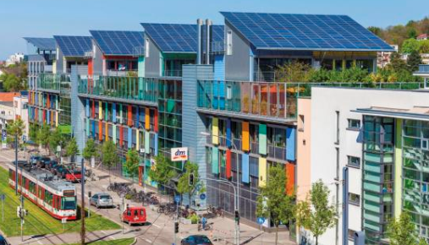
Urban sustainability: Freiburg, Germany
Social sus:
locals invest in renewable energy & get free football tickets
Env sus:
re-use & recycle waste
Vauban: brownfield, low energy, green roofs.
Economic sustainability:
250 jobs in Solar Valley / environmental businesses

Slide 24
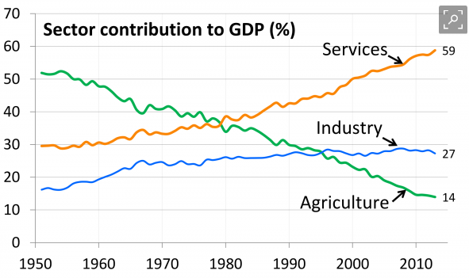
Economic change in a NEE or LIC: India
Former British colony
Reduced tariffs = more trade.
HDI = 0.61
Globalisation
Outsourcing of call centres & IT services
Economic growth affects the environment
Short term aid from NGOS
TNCs e.g. Unilever
+ / -
Top down / bottom up aid

Slide 25
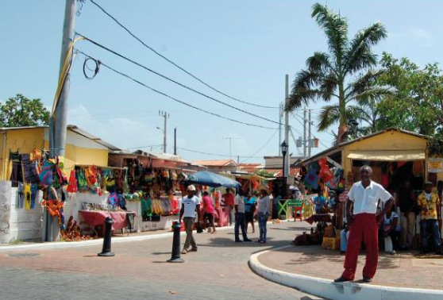
Tourism to reduce the development gap in a LIC or NEE: Jamaica.
-
+
Money goes to TNCs
24% of GDP
$2bn / yr income
Volatile industry
200,000 jobs
Low skill - low paid jobs
Multiplier effect
Env damage

Slide 26
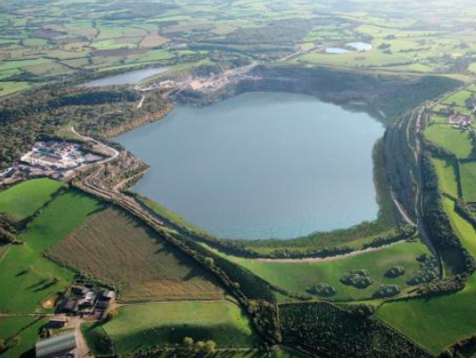
How modern industry can be more sustainable: Tor Quarry, Somerset
Monitor noise and air pollution from lorries and quarrying
Restore lake for wildlife
Trees planted
Rail transport = less disruption & pollution

Slide 27
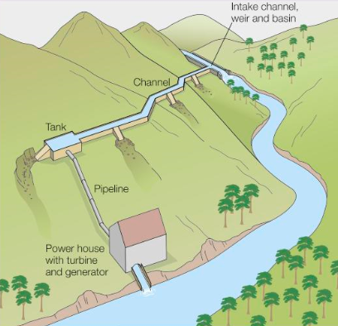
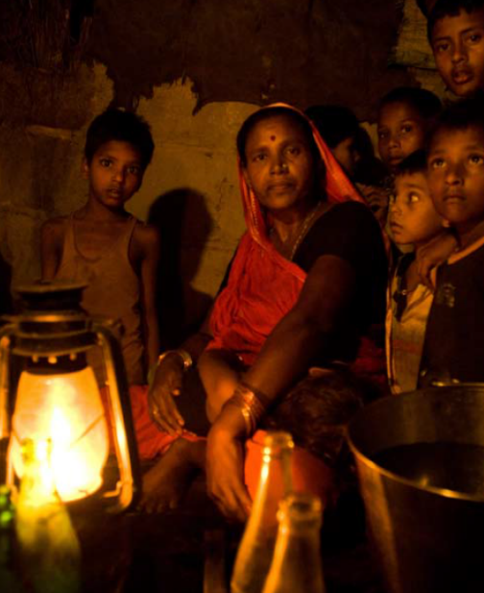
Example of a local energy scheme in a LIC: Chambamontera micro-hydro
or Bihar, India
Burn rice husks = biomass

